Slide 1
IEEE1 904.3 Radio over Ethernet update
Jouni Korhonen
IEEE 802.1TSN @Berlin 2015

Slide 2
Disclaimer
This is not an official IEEE 1904 WG output; just an informal update what is happening regarding Radio over Ethernet in IEEE 1904.3.

Slide 3
What, when and where..
What:
  Standards development for Radio over Ethernet (RoE) encapsulation and a CPRI mapper.
  Quite close what IEEE 1722 is for AVB..
When:
  F2f meeting ~every second month.
  Biweekly telcos to discuss technical details (information available in IEEE 1904.3 reflector).
Where:
  Hosted by IEEE 1904 ANWG as a IEEE 1904.3 TF.
  IEEE 1904.3 is individual project and anyone can join.

Slide 4
Progress since Atlanta update
IEEE 1904.3 TF formed.
First f2f held in Feb. 2015.
  Mostly procedural to get things up & running.
  Next in April 1-3, 2015; Louisville, CO USA.
Three telcos since the first f2f. Agreed on the baseline for the work (to be ratified in the f2f meeting):
  Fixed the mapper & encap/decap function assumptions;
  1 EtherType only; subtypes in the header;
  1 type flow per packet (e.g. one AxC);
  Prepare for supporting both CBR & VBR flows;
  Both seqnos and timestamps needed;
  Alignment with 1588 datatypes desirable;
  Reference time set to TAI;

Slide 5
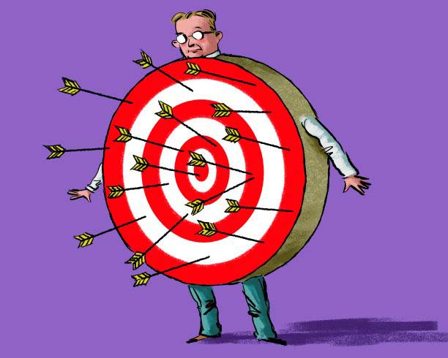
Q & A
More data available:
  http://www.ieee1904.org/3/index.shtml

