Slide 1
IEEE 802 Privacy concerns about 802c PAR
Date: [2014-11-03]
Authors:
Name | Affiliation | Phone | Email
Juan Carlos Zuniga | InterDigital Labs |  | j.c.zuniga@ieee.org
Notice: This document does not represent the agreed view of the IEEE 802 EC Privacy Recommendation SG. It represents only the views of the participants listed in the ‘Authors:’ field above. It is offered as a basis for discussion. It is not binding on the contributor, who reserve the right to add, amend or withdraw material contained herein.
Copyright policy: The contributor is familiar with the IEEE-SA Copyright Policy <http://standards.ieee.org/IPR/copyrightpolicy.html>.
Patent policy: The contributor is familiar with the IEEE-SA Patent Policy and Procedures: <http://standards.ieee.org/guides/bylaws/sect6-7.html#6> and <http://standards.ieee.org/guides/opman/sect6.html#6.3>.
Abstract
The present document aims to summarize the Privacy SG discussions related to the 802c PAR.

Slide 2
IEEE 802c - Privacy Concerns
Juan Carlos Zúñiga

Slide 3
Privacy and 802c PAR
Long lived identifiers associated with a user, such as MAC addresses, have been identified as privacy risks in 802 protocols
The potential 802c recommendations and rules for the use of the local address space would have direct implications on privacy issues and possible solutions being considered in the group

Slide 4
802c PAR Proposal
The amendment proposes allocating a portion of the address space for protocols using an IEEE Registration Authority assigned Company ID (CID)
Another portion of the local address space will be allocated for assignment by local administrators

Slide 5
MAC Address Randomization
MAC address randomization has been identified as a potential solution to the surveillance privacy threat related to the use of clear globally unique MAC addresses for over the air transmissions
In some cases, these transmissions take place before full L2 network data connectivity is achieved (e.g. network scanning), making it impossible to coordinate with a network entity before transmitting

Slide 6
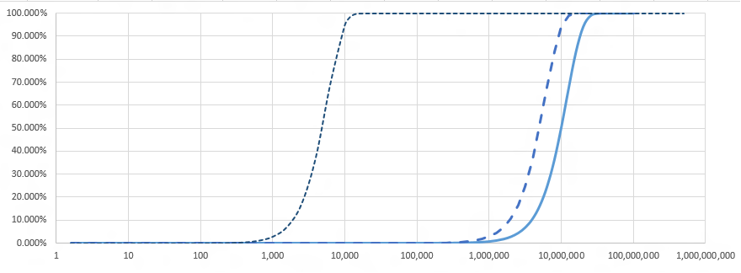
Collision Probability
Collision probability as a function of the size of the network, for 24, 44 and 46 bits
Large WiFi deployments in the order of 30k STAs:
Very high probability of address collision with 24 bits
Source: Christian Huitema http://grouper.ieee.org/groups/802/PrivRecsg/email/msg00102.html

Slide 7
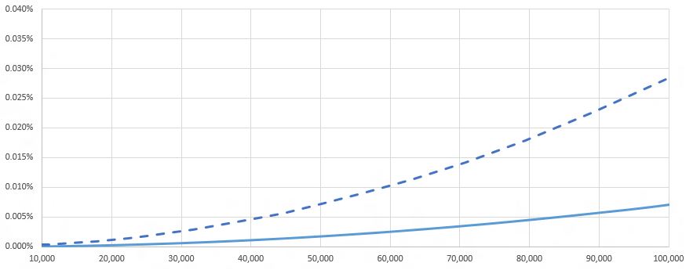
Collision Probability – Detail
Magnification between 10,000 and 100,000 nodes
Large WiFi deployments in the order of 30k STAs:
Significant difference in probability of collision between 44 and 46 bits
Source: Christian Huitema http://grouper.ieee.org/groups/802/PrivRecsg/email/msg00102.html

Slide 8
Resources
EC Privacy Recommendation SG Info
  http://www.ieee802.org/PrivRecsg/
Email archive
  http://grouper.ieee.org/groups/802/PrivRecsg/email/index.html

