Slide 1
Introduction to
OmniRAN EC SG
2013-03-18
Max Riegel
(OmniRAN SG Chair)

Slide 2


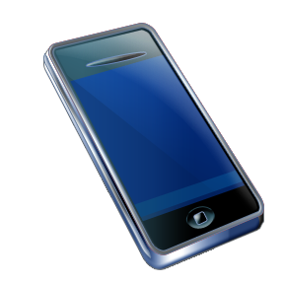
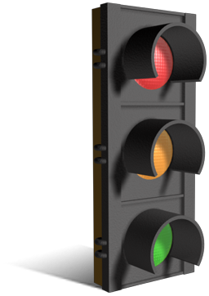
OmniRAN EC SG
OmniRAN EC SG was established by Nov 2012 Closing EC meeting.
  First meeting took place in January 2013
OmniRAN is about network support for attaching terminal devices deploying IEEE 802 technologies to communication networks.
OmniRAN aims to define interfaces and network functions for access networks based on IEEE 802 technologies
  including IEEE 802.3!
BTW: What does OmniRAN stand for?
  Open mobile network interface for omni-Range Area Networks

Slide 3
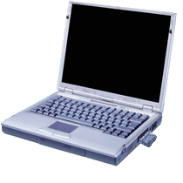
Dynamic attachment of terminals to networks
Terminal
Access Network
Core
Network
Services
Internet
Communication networks supporting dynamic attachment of terminals are usually structured into
  Access Network
    Distributed infrastructure for aggregation of multiple network access interfaces into a common interface
  Core Network
    Infrastructure for control and management of network access and end-to-end IP connectivity
  Services
    Infrastructure for providing services on top of established IP connectivity

Slide 4
Network Support Functions for
Dynamic Attachements of Terminals
Network detection and selection
  Finding the most appropriate network access
Setting up the access link
  Scope of individual IEEE 802.xx specifications
Authentication
  Framework, based on IEEE 802.1X
Setting up the e2e communication link
  Authorization, service management
Maintaining the user data connection when changing access,
  Mobility support, including solutions based on IEEE 802.21
Usage and inventory reporting
  Accounting, service monitoring, location
Subscription management
  Adding new users to a network and maintaining existing subscriptions
Management of terminals
  Initial configuration and provisioning and update of policies

Slide 5
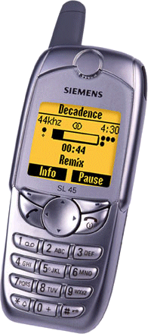
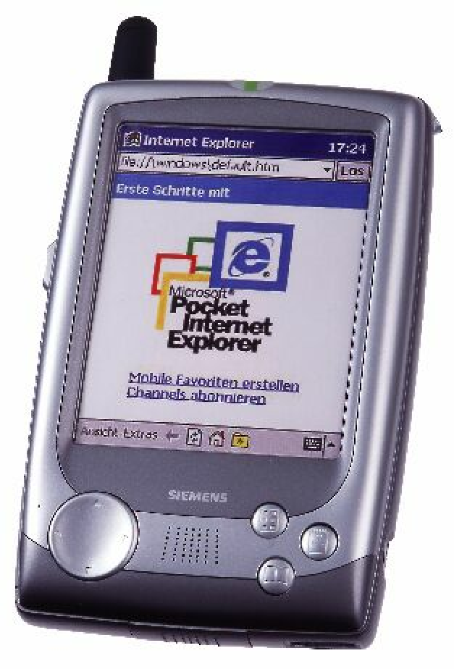
‘Legacy’ Communication Networks have solved the issues
Specific scope:
Close relationship between user terminal, access network and service provider
  Single interface in terminal
  Single access network topology
  Single operator
    single entity (operator, IT department) controls complete service chain
Operators with long-time experience in network operation.
Core
Access

Slide 6

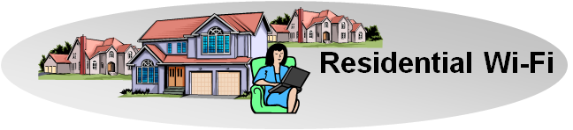
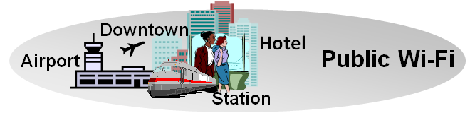
IEEE 802 may need broader scope e.g. Hetereogeneous Networks
User-Terminals have to support
  multiple network interfaces
    e.g. Cellular, IEEE 802.3, IEEE 802.11, …
  multiple access network topologies
    e.g. IEEE802.11 in residential, corporate and public
  multiple network subscriptions
    e.g. multiple subscriptions for same interface
Generic solution to cope with complexity
Cellular
802.11
802.15

Slide 7
IEEE 802 may need cookbook solutions e.g. Emerging Networking Markets
Many more (huge) networks are coming up by everything gets connected
  e.g. SmartGrid, HomeAutomation, Car, …
Many new markets for IEEE 802 access technologies
  e.g. factory automation, in-car communication
New deployments often suffering by the same old networking issues
  e.g. service control, security, provisioning
  new operators lacking long-time experience
Generic solution to foster market growth

Slide 8
Structuring the effort:
OmniRAN Architecture and Reference Points
Terminal
R2
Access
Core
R1
R3
Internet
R4
R3
Access
Core
R3
Access
Authentication
Authentication
Authorization
Authorization
R5
Accounting
Accounting
Location
Location
CoA
CoA
Mobility
DataPath
Mobility
Access
R3
Core
Encapsulation
Encapsulation
Transport
Internet
Reference Points represent a bundle of protocols between peer entities
  - Similar to real IP network interfaces

Slide 9
OmniRAN Deliverables:
Specifications of Network Interfaces
R1: Access link, technology specific
R2: User & terminal authentication, subscription & terminal management
R3: Authorization, service management, user data connection, mobility support, accounting, location
R4: Inter-access network coordination and cooperation, fast inter-technology handover
R5: Inter-operator roaming control interface
All interfaces may comprise a number of different protocols. However, only the protocols related to required functionality have to be present on the interfaces.
  Approach allows for a common specification framework for various applications covering very simple to extremely complex network functionality.

Slide 10
Heterogeneous Networking w/ OmniRAN

Slide 11
What OmniRAN would provide to 3GPP
SaMOG is defining a gateway controlling the Trusted Non-3GPP access network by the EPC
OmniRAN would provide an interface (R3) to which 3GPP would be able to reference.
  Expanded beyond IEEE 802.11/802.16
R3

Slide 12
No desire to re-invent the wheel…
Limiting the effort to create beneficial results
There are plenty of specifications available which OmniRAN can leverage
  IETF protocols
  WiMAX specifications
  Wi-Fi Alliance solutions
  ZigBee specifications
  …
Step-wise development allows to provide valuable results early, e.g.:
  Interface by interface
    e.g. starting with R1 and R2, then R3, adding R4 and R5 later
  Functional complexity
    e.g. starting with simple nomadic scenario, adding dynamic service control, later L3 mobility management and inter-AN optimizations
  …
OmniRAN SG is searching for the most wanted topic to be solved for IEEE 802 access networks.

Slide 13
Planned Timeline of OmniRAN EC SG
Initial meeting
Use cases contributions
Draft Use cases document
Call for comments on Use cases document
Use cases document finalization
Classification of functional requirements
Prioritization of functional requirements
Gap analysis to existing solutions
Decision about initial topic
Draft PAR proposal
Finalization of PAR proposal
Conf Call
?
?
?
?
F2F meeting
Jan
Feb
Mar
Apr
May
Jun
Jul

Slide 14
Questions and Comments?

