Slide 1
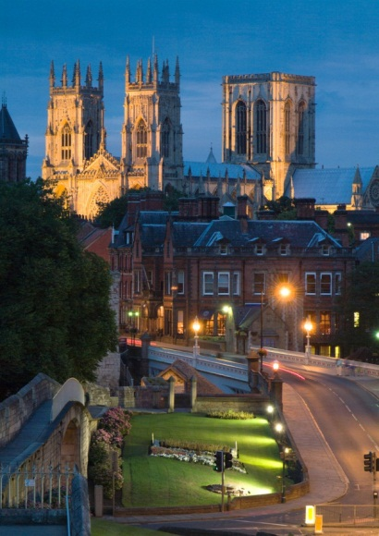
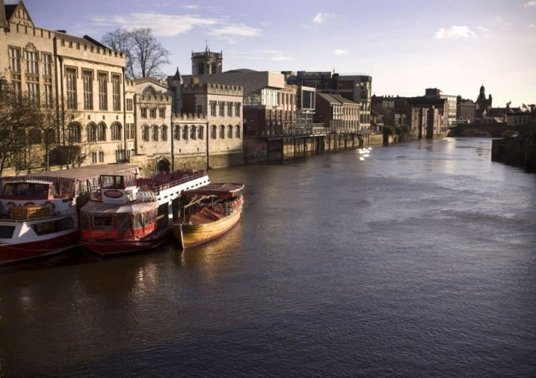
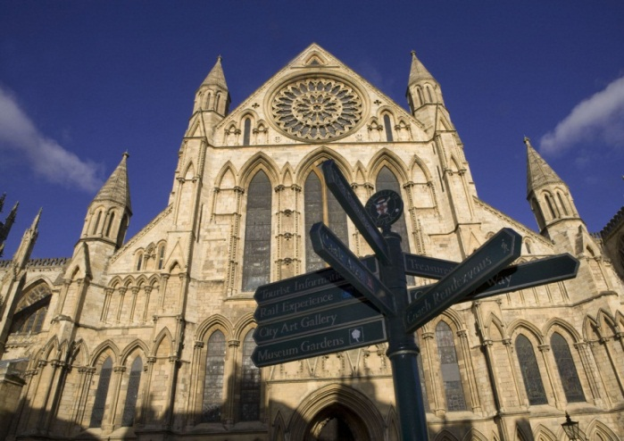


802.1/802.3 Joint Interim Meeting 2nd – 6th September 2013
Delegate Information Pack

Slide 2
York
You'll fall in love with York from the moment you arrive...
With its rich ancient history, romantic ambience and fun activities, York is the perfect holiday destination for couples, families and groups. Renowned for its exquisite architecture, tangle of quaint cobbled streets, iconic York Minster and wealth of visitor attractions, York is a flourishing city, just two hours by train from London.
Delve into the city's vibrant café culture, take time out to enjoy some of the country's most talented street entertainers or simply watch the world go by while sipping a drink by the river.
With hundreds of attractions, museums, historic buildings, tours, shops, restaurants and bars within the compact walled city you’re never far from an awe inspiring moment.

Slide 3
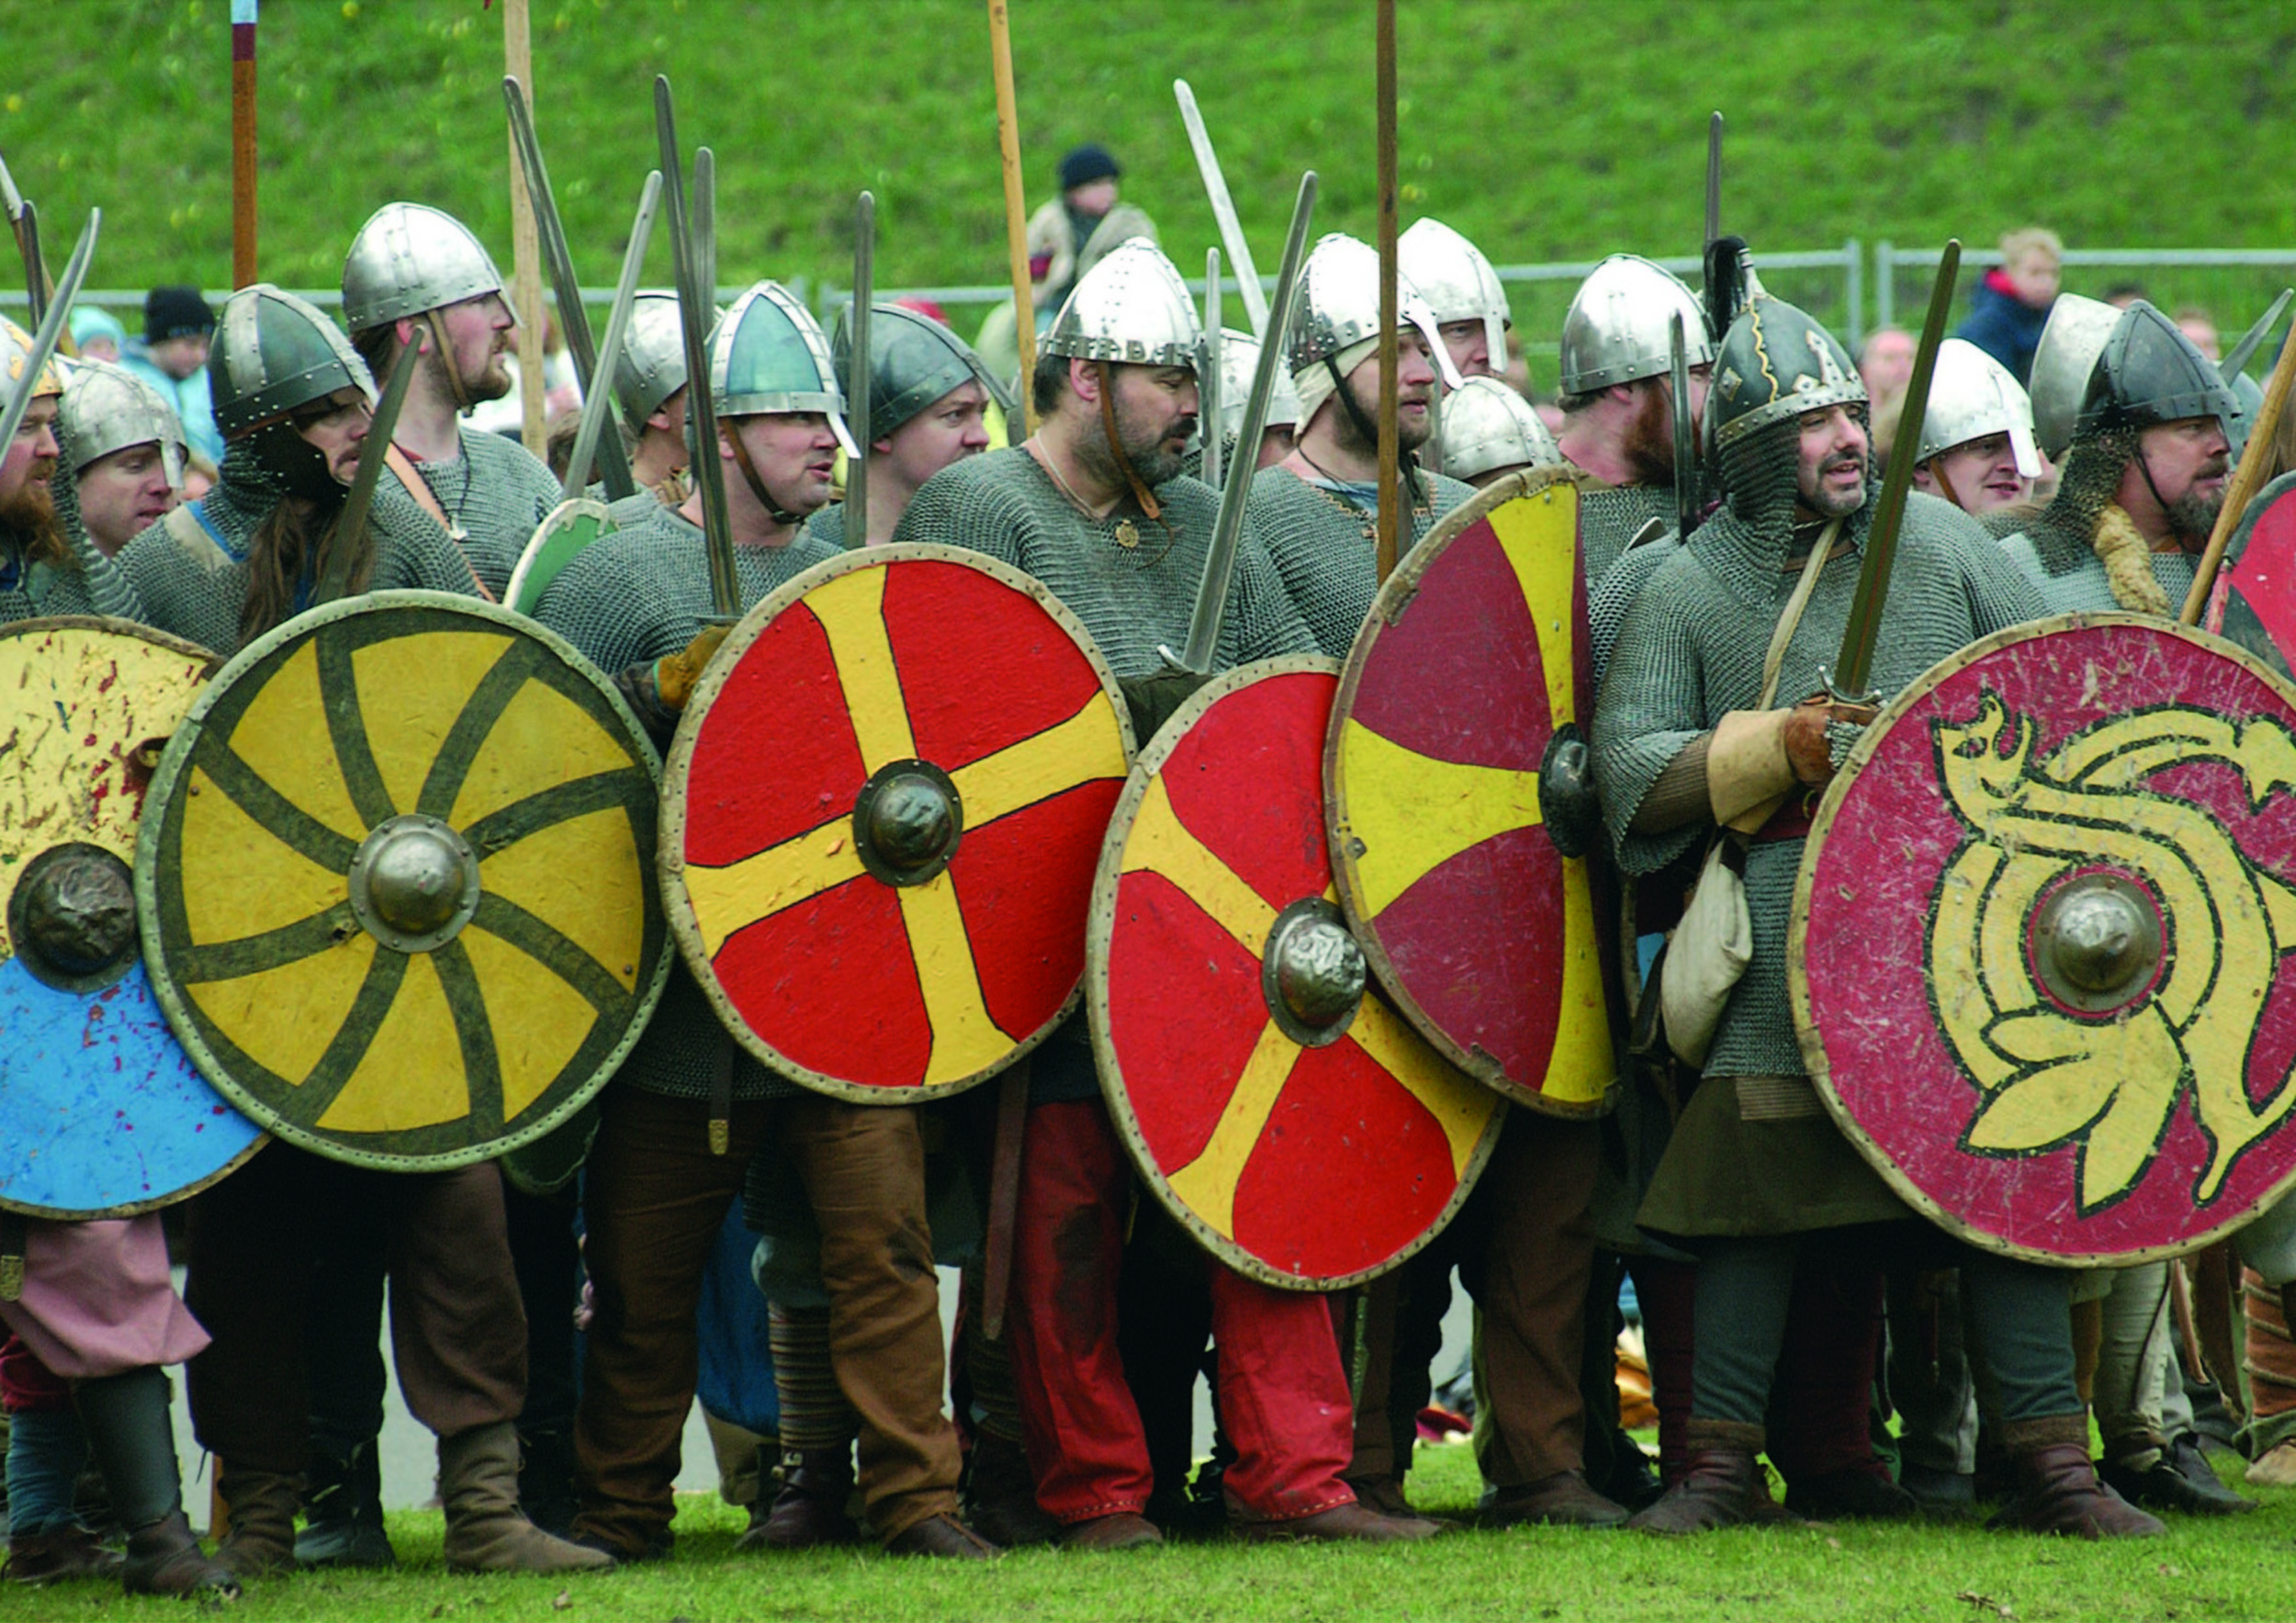
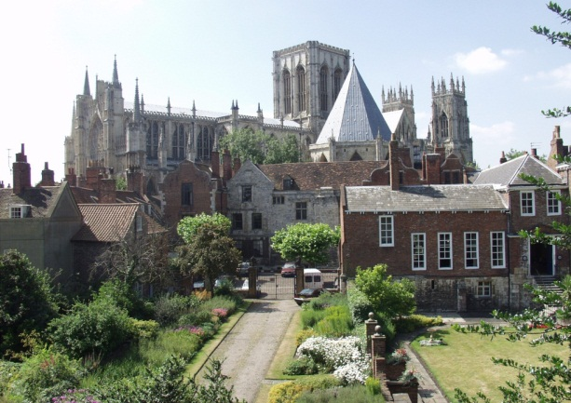
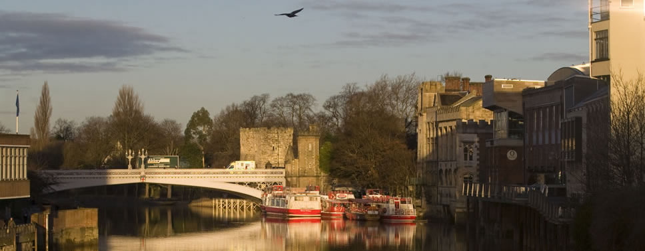
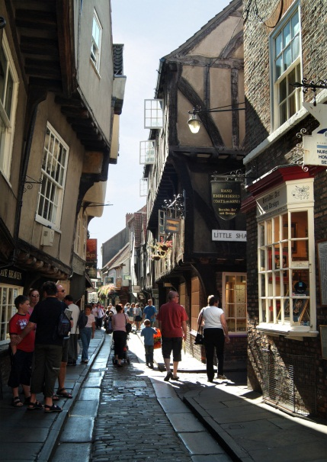
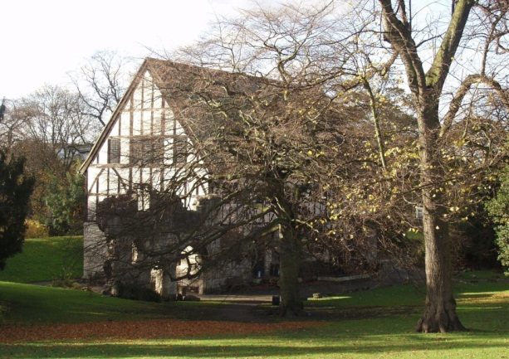
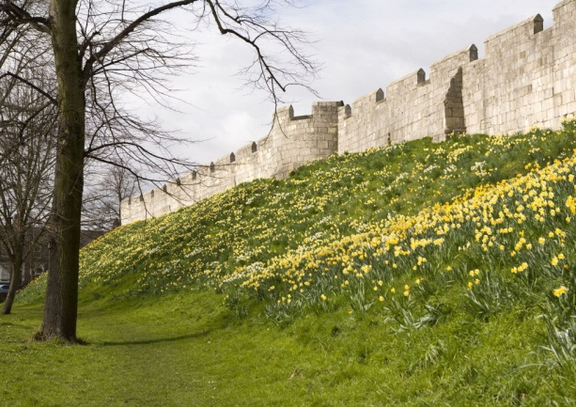
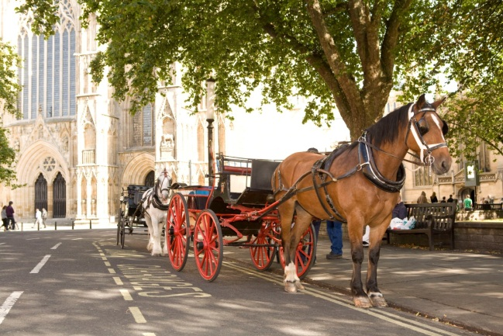
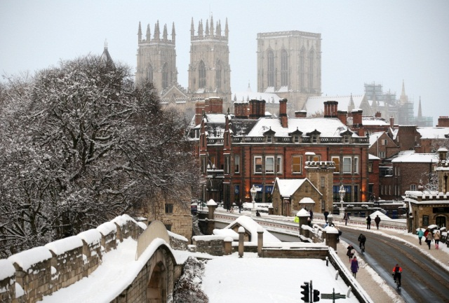
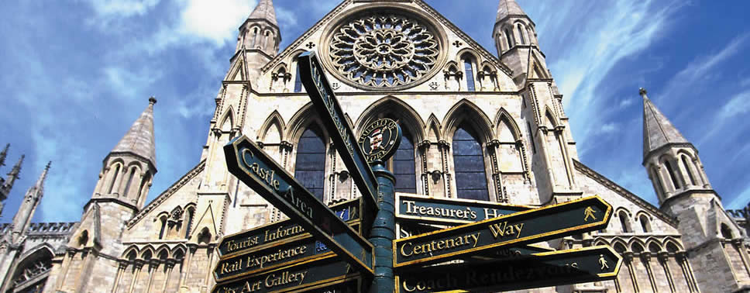
York

Slide 4
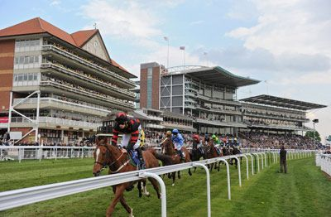
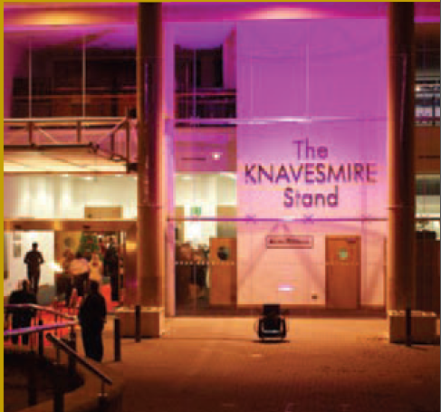
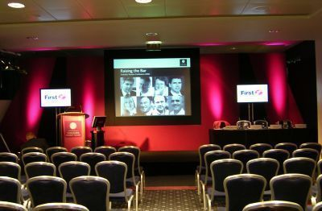
York Racecourse
The meeting will be held at York Racecourse (The Knavesmire Grandstand), situated just outside the City Centre, easily accessible on foot or by public transport.
The ground floor houses the dining facility where delegates can be seated for lunch or for breakout sessions throughout the day.

Slide 5
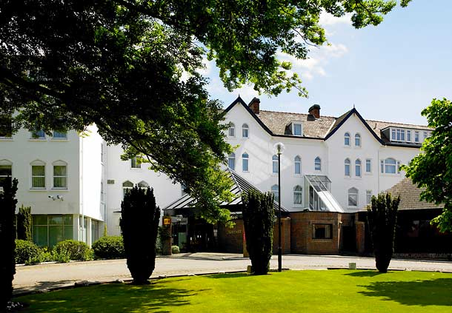
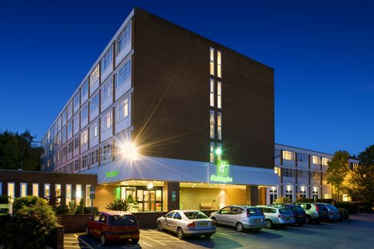
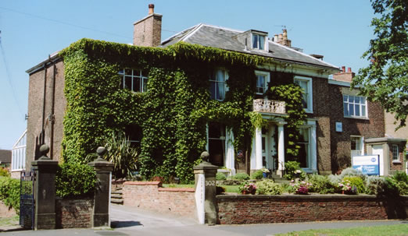
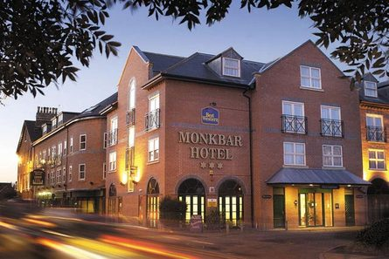
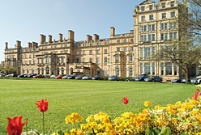
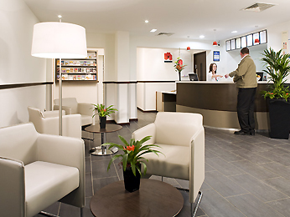
Accommodation
The following slides show various hotels, along with prices and reservation information. Accommodation in September soon gets booked so it is advisable to secure your accommodation as soon as possible.

Slide 6
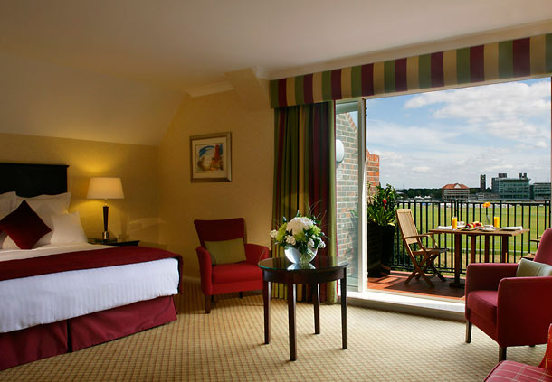
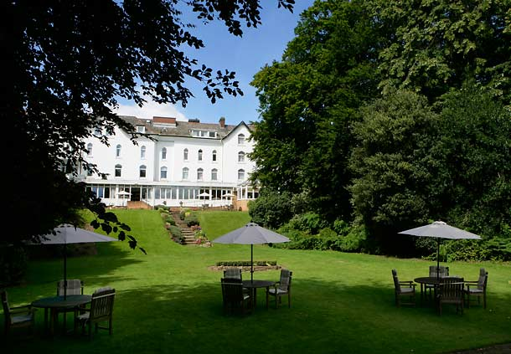
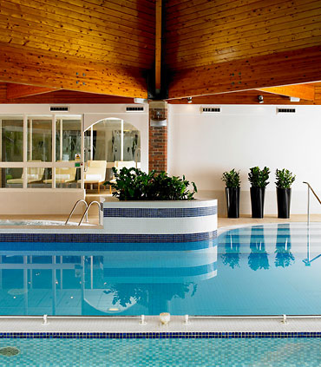
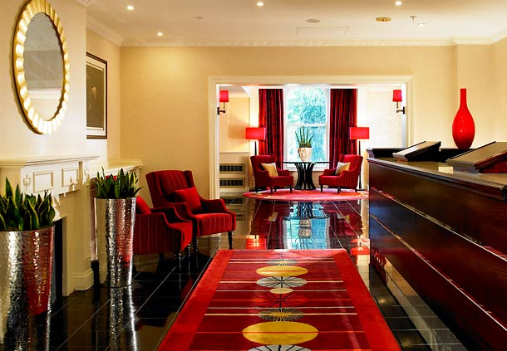
York Marriott Hotel
The York Marriott Hotel is within walking distance of York city centre and its many attractions including the National Railway Museum & York Minster. It is also one of the closest hotel to York Racecourse. With 151 stylish guest bedrooms the hotel is ideal for the Business or Social traveller. WIFI internet access is available in public areas and our Leisure Club features a heated pool, sauna, steam room, jacuzzi, gymnasium & private tennis court. The Chase Bar & Grill serves a varied menu and offers a wide choice of refreshments whilst offering unrivalled views of York Racecourse from its sun terrace.

Slide 7
York Marriott Hotel
Tadcaster Road, York. YO24 1QQ
http://www.marriott.com/hotels/travel/qqyyk?groupCode=ad8ad8a&app=resvlink&fromDate=8/31/13&toDate=9/6/13
Single Occupancy: £105.00
Double Occupancy: £115.00
To reserve accommodation at the York Marriott Hotel:-
Please use the above link or telephone +44 1904 770645
Please quote ‘IEEE Group’ when making a reservation at the hotel.
Cancellation Policy: By 12:00 p.m. on day of arrival.

Slide 8
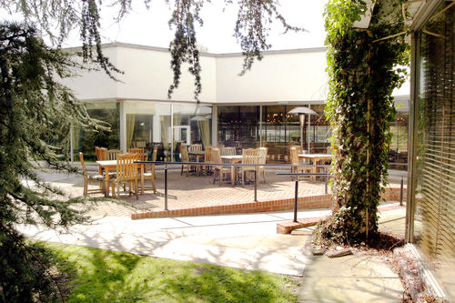
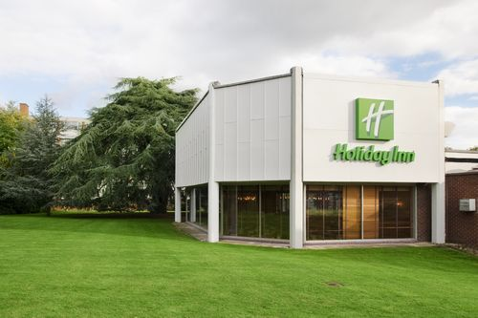
Holiday Inn
Receive a warm welcome at the Holiday Inn York hotel, next to York Racecourse and 2 miles from York city centre.
The friendly Holiday Inn York is set in leafy grounds with plenty of complimentary parking. It's a 15-minute drive to York city centre from the bus stop adjacent to us. Upgrade to an Executive room for extra home comforts such and bathrobes, upgraded toiletries, 40" flat screen TV and mineral water and chocolate. Wireless Internet is available in our attractive Lobby with oak furnishings, and you can take drinks onto the tree-lined patios.

Slide 9
Holiday Inn
Tadcaster Road, York. YO24 1QF
http://www.holidayinn.com/hotels/gb/en/york/yortr/hoteldetail
Single Occupancy: £89.00
Double Occupancy: £99.00
To reserve accommodation at the Holiday Inn:-
E-mail: reservations-york@ihg.com
Telephone: +44 1904 777541 (Anita Barrett)
Please state Group Code GX2 (IEEE Consortium)
Cancellation Policy: 7 days before date of arrival.

Slide 10
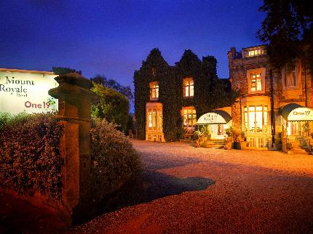
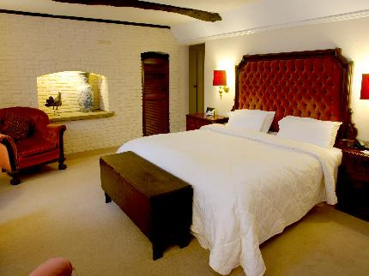
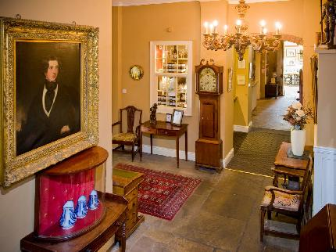
Mount Royale Hotel
This luxurious hotel is unique in a number of ways, but none more so than its county house feel and beautiful surrounding gardens, something not often associated with an inner city hotel. The Mount Royale Hotel is situated at the top of The Mount, which is one of the oldest and most picturesque approaches into the historic City of York.
The Mount Royale Hotel is just a few minutes walk from the hustle and bustle of York's City Centre and all its attractions, additionally York Racecourse is also a short walk away, making the hotel ideal for race goers.

Slide 11
Mount Royale Hotel
117 – 119 The Mount, York. YO24 1GU
http://www.mountroyale.co.uk/
Single occupancy £80.00
Double occupancy £100.00
To reserve accommodation at The Mount Royale Hotel:-
Telephone: +44 1904 628856
E-mail: info@mountroyale.co.uk
Please quote reference ‘ADVA Corporate Rate’ when making a reservation at the hotel.
Cancellation Policy: 24 hours before day of arrival.

Slide 12
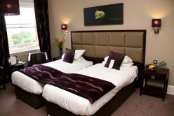
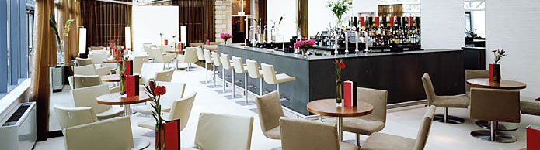
Royal York Hotel
The Royal York Hotel is located in the heart of this beautiful historic city, surrounded by gardens with spectacular views. The Hotel is conveniently situated next to York Railway station. The hotel elegantly presents the history of the property combined with modern facilities and luxurious furnishings.

Slide 13
Royal York Hotel
Station Road, York. YO24 2AA
http://www.royalhotelyork.co.uk/
Single occupancy 2nd September £119.00
3rd September £129.00
4th September £129.00
5th September £119.00
6th September £139.00
7th September £159.00
8th September £109.00
Double occupancy £10.00 per night extra on the above rates
To reserve accommodation at The Royal York Hotel:-
Telephone: +44 1904 653681
E-mail: royalyork.reservations@principal-hayley.com
Please quote ‘IEEE Group’ when making a reservation at the hotel.
Cancellation Policy: By 2:00 p.m. day prior to arrival.

Slide 14
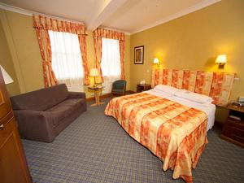
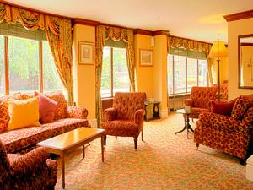
Monkbar Hotel
The Monkbar Hotel is at the very heart of York, overlooking the City walls and close to the very best that this vibrant and historic city has to offer. There's a wide choice of conference rooms and training suites for up to one hundred delegates, comfortable lounges, welcoming restaurant and bar and elegant Courtyard garden.
The only hotel at the centre of York to offer free parking for residents, and free WiFi Internet access throughout the hotel, winner of the Silver Award from Green Tourism for commitment to the environment.

Slide 15
Monkbar Hotel
St. Maurices Road, York. YO31 7JA
http://www.bw-monkbarhotelyork.co.uk/
Single Occupancy £105.00 per night
Double Occupancy £125.00 per night
To reserve accommodation at The Monkbar Hotel:-
Telephone: +44 1904 667701 (Lynn Fairweather)
E-mail: Reservations@monkbarhotel.co.uk
Please quote IEEE when making a reservation at the hotel.
Cancellation Policy: 48 hours notice.

Slide 16
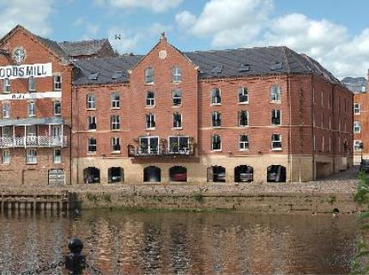
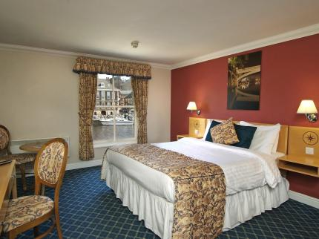
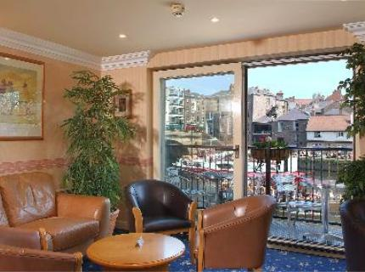
Queens Hotel
A warm welcome awaits you at The Queen's Hotel, which is situated on the banks of the River Ouse, in the heart of the City of York. The Queen's Hotel is perfectly located to suit all visitors whether tourist or on business.
Step out of the Hotel into a world of history and explore the meant dimensions York has to offer, from medieval times to modern day.
The hotel is approximately a 15 minute walk to the Racecourse along the banks of the River Ouse.

Slide 17
Queens Hotel
Queens Staith Road, Skeldergate, York. YO1 6DH
http://www.queenshotel-york.com/
Single occupancy £64.50
Double occupancy £72.45
To reserve accommodation at The Queens Hotel:-
Telephone: +44 1904 650699
E-mail: groups@queenshotel.york.com
Please quote reference 344775 when making a reservation at the hotel.
Cancellation Policy: 24 hours notice.

Slide 18
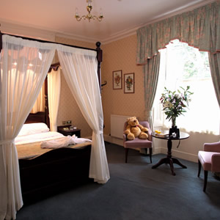
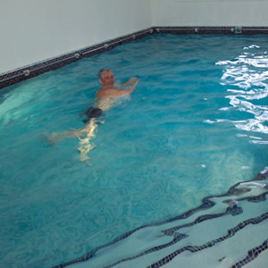
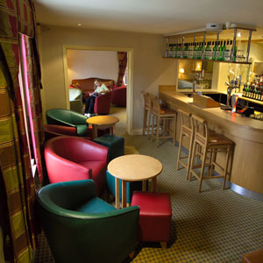
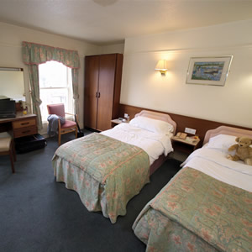
Newington Hotel
Situated on the Royal Approach and right next to York Racecourse, the Newington Hotel is York Tourist Board graded, family-run hotel, which is a perfect base for your visit to historic York.
Totally Free WI-FI now available. With 44 en-suite bedrooms, we can cater for single travellers, families, couples and groups and we promise to make your stay with us as relaxing, enjoyable and comfortable as possible.
Our indoor heated pool and sauna area creates a relaxing haven in which to unwind after a hard day at work, shopping or sightseeing.

Slide 19
Newington Hotel
147 – 157 Mount Vale, York. YO24 1DJ
http://www.thenewington.co.uk/
No set rates for the hotel have been issued. Please contact them directly for prices.
Current online prices range from £95.00 per night.
Telephone: +44 1904 625173

Slide 20
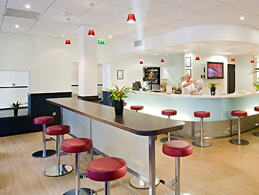
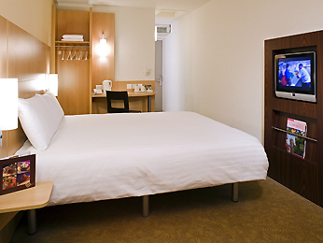
Ibis Hotel
Ibis York Centre hotel is a budget hotel, located at the gates of the city walls, within a short walking distance from the Train Station and the main city centre. The National Railway museum and York's Racecourses are within a short walking or driving distance. The en-suite accommodation comes with internet access and with satellite TV. Facilities include Café and bar offering hot and cold snacks 24 hours a day, WIFI, two modern meeting rooms and limited outdoor car parking for up to 20 cars.

Slide 21
Ibis Hotel
77 The Mount, York. YO24 1BN
http://ibishotel.ibis.com/gb/united-kingdom/index.shtml
No set rates for the hotel have been issued. Please contact them directly for prices.
Current online prices range from £60.00 per night.
Telephone: +44 1904 658301

Slide 22
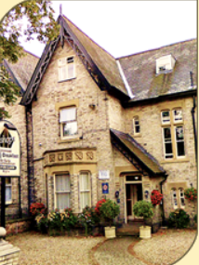
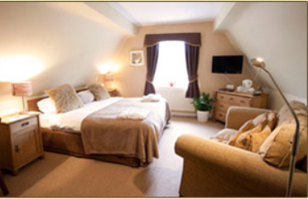
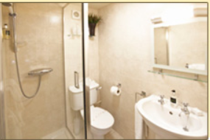
Bishops Guest House
Bishops is an award winning, beautifully restored Victorian villa with individually designed en-suite bedrooms.
Excellent service in comfortable surroundings. Bishops is a fully licensed, non smoking Bed & Breakfast with 5 stars.

Slide 23
Bishops Guest House
135 Holgate Road, York, YO24 4DF
www.bishopsyork.co.uk
Single Occupancy £70.00 (Standard Double Room)
Double Occupancy: £95.00 (Standard Double Room)
Single Occupancy: £80.00 (Superior Double Room)
Double Occupancy: £110.00 (Superior Double Room)
To reserve accommodation at Bishops Guest House:-
E-mail: enquiries@bishopsyork.co.uk
Telephone: +44 1904 628000
Please state you are part of the IEEE Group attending a conference at York Racecourse when booking.

Slide 24
Distance / costs from hotels to Racecourse
York Marriott Hotel
Taxi £5.00 - £6.00 Walking 20 minutes
Royal York Hotel
Taxi £6.00 - £7.00 Walking 30 minutes
Monkbar Hotel
Taxi £7.00 - £8.00 Walking 45 minutes
Holiday Inn
Taxi £5.00 - £6.00 Walking 25 minutes
Newington Hotel
Taxi £5.00 Walking 10 minutes
Ibis Hotel
Taxi £6.00- - £7.00 Walking 20 minutes
The Mount Royale
Taxi £5.00 - £7.00 Walking 20 minutes
Queens Hotel
Taxi £7.00 - £9 00 Walking 15 minutes
Bishops Guest House
Taxi £5.00 - £6.00 Walking 10 minutes
Please note these are estimated costs and times.

Slide 25
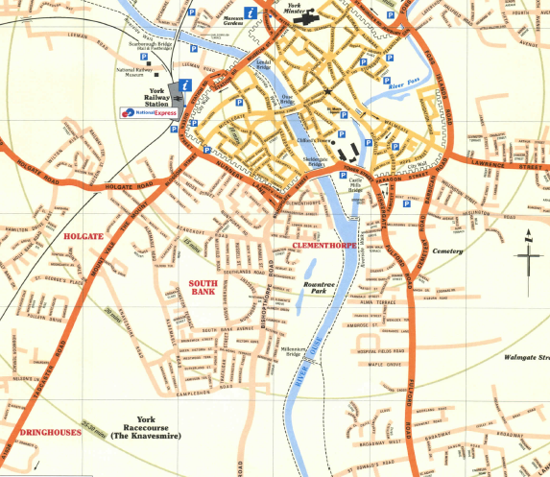
Mount Royale
Queens Hotel
Bishops Guest House
NRM
Monkbar Hotel
Royal York Hotel
Newington Hotel
Ibis Hotel
Marriott
Holiday Inn
Premier Inns

Slide 26
Alternative Accommodation
Hotel du Vin www.hotelduvin.com/york (prices from £185.00)
Middlethorpe Hall www.middlethorpe.com (prices from £129.00)
Best Western Kilima Hotel www.bestwestern.co.uk/kilima_hotel (prices from £104.00)
Premier Inn (York City) http://www.premierinn.com/en/checkHotel/YORPTI/york-city-blossom-st-north
Premier Inn (York) http://www.premierinn.com/en/checkHotel/YORTAB/york-city-blossom-st-south
(prices from £77.00)
Park Inn www.parkinn.co.uk/hotel_york (prices from £71.20)
Cedar Court Grand www.cedarcourtgrand.co.uk (prices from £115.00)
Novotel http://www.novotel.com/gb/hotel-0949-novotel-york-centre/index.shtml
(prices from £69.00)
Hilton Hotel http://www3.hilton.com/en/hotels/united-kingdom/hilton-york-hotel-LBAYOHN/index.html?WT.srch=1 (prices from £99.00)
Hotel 53 http://www.hotel53.com/ (prices from £100.00)
The Churchill Hotel http://www.churchillhotel.com/ (prices from £70.00)
Knavesmire Manor Hotel http://www.knavesmire.co.uk/ (Prices from £85.00)
Best Western Dean Court Hotel http://www.deancourt-york.co.uk/ (Prices from £103.50)
Elm Bank Hotel www.elmbankhotel.com (prices from £70.00)

Slide 27
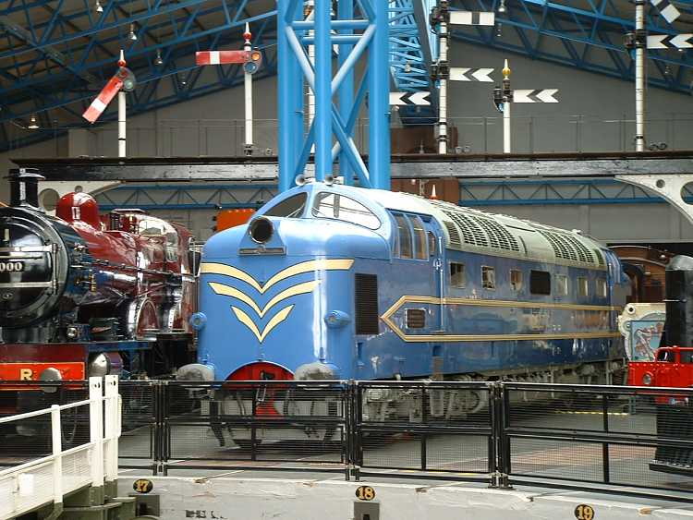
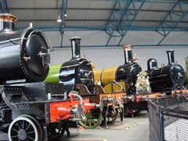
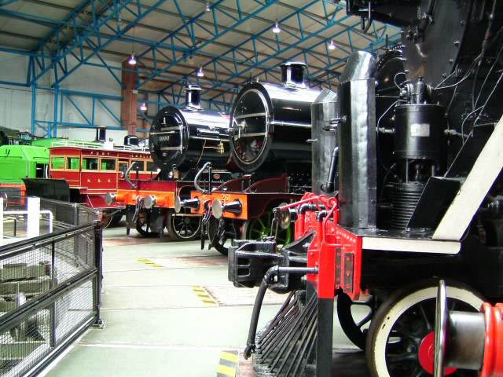
Social Event
4th September 2013
National Railway Museum

Slide 28
Visas
Attendees from some countries may require a visa to visit the United Kingdom.
If you require a visa invitation letter, please complete the following form and e-mail it to:
september2013meeting@advaoptical.com
ADVA Optical Networking will then send you an invitation letter.
Please ensure you apply in good time.

Slide 29
Invitation Letter request for a Visa Application to enter the United Kingdom
Full Name
Title | Dr: _______________ Mr: ______________ Mrs: ________________ Ms: _________________
Date of Birth (DD-MM-YYYY)
Name of Company
Job title
Contact Address
Telephone Number
E-mail address
Passport Number
Passport – place of issue
Passport Expiration Date (DD-MM-YYYY)
Nationality
Expected Travel date to the UK (DD-MM-YYYY)
Expected Departure date (DD-MM-YYYY)
Please state to whom the letter should be addressed: (e.g. Consulate of …………….. and the full address) | Name: Address:

Slide 30
Getting to York
York is in easy travelling distance of various International Airports:-
Leeds Bradford Airport:
Take the 757 bus from the Airport to Leeds Train Station where there are frequent trains to York.
Alternatively a taxi will cost in the region of £45.00 (one way)
Manchester Airport:
Take the train from the Airport. Journeys to York take approximately 1 hour 50 minutes. Return fares are in the region of £28.00. www.nationalrail.co.uk
Heathrow Airport:
Take the Heathrow Express train from the Airport to London Paddington (approximately 20 minutes). Here you will take the Underground to London Kings Cross (approximately 40 minutes). Trains from Kings Cross take approximately 2 hours and 15 minutes to reach York. Fares vary considerably. www.nationalrail.co.uk
Gatwick Airport:
Take the Gatwick Express train(www.gatwickexpress.com) from the Airport to London Victoria Station (approximately 30 minutes). Here you will take the Underground to London Kings Cross (approximately 23 minutes). Trains from Kings Cross take approximately 2 hours and 15 minutes to reach York. Fares vary considerably. www.nationalrail.co.uk
London City Airport:
Take the Docklands Light Railway (DLR) train direct from the Airport to London Kings Cross Railway Station. Journeys take approximately 32 minutes. www.londoncityairport.com then click on the tab ‘To and From the Airport’ to access the DLR site or alternatively visit http://www.tfl.gov.uk/modalpages/2632.aspx.

Slide 31


Getting to York
By Air
Leeds Bradford Airport: www.lbia.co.uk
Manchester Airport: www.manchesterairport.co.uk
Heathrow Airport: www.heathrowairport.co.uk
Gatwick Airport: www.gatwickairport.co.uk
London City Airport: www.londoncityairport.com
By Road
York is situated midway between Edinburgh and London, just 20 miles from the M1 / M62 Motorway network, making a comfortable travelling time from most regions in the UK.
Accurate route plans can be obtained from www.theaa.com.
NB: cark parking in York is scarce and expensive.

Slide 32





York Tourism Links
For more information on York and its surrounding area please visit:
http://www.visityork.org
Where you will find a wide range of attractions, hotels, things to do and see, recommendations for eating out and historical facts.

Slide 33
Contact Information
If you require any further information or assistance in locating suitable accommodation please contact:
Judi Steel
Office: +44 1905 699335
Mobile: +44 7825 064703
E-mail: september2013meeting@advaoptical.com

Slide 34

Thank You
We look forward to welcoming you to York in September 2013.
John & Judi

