Slide 1
Alternative solution for EC Type II support
Maarten Vissers
2011-09-20

Slide 2
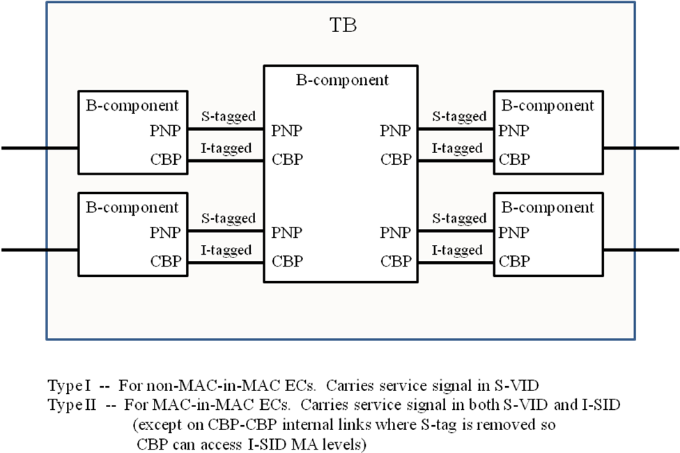
Introduction
liaison-haddock-proposed-response-q10-15-277-eotn-0511-v01 presents the model of a Transport Bridge supporting EC Type I and II signals
new-vissers-generalized-ec-type-2-support-0711-v01 reports negative feedback from the operator community on the I+S-Tagging of EC Type II signals
This tagging is
  Not backwards compatible with existing S-Tagging on NNI ports
  Not client agnostic on NNI ports
An alternative solution is required which is backwards compatible with S-Tagging on NNI ports and is client agnostic on NNI ports

Slide 3
Alternative Solution
TB
S-Component
Transport Bridge (TB) is supported by a S-Component with Provider, OTN and/or SDH Network Ports providing S-Tagging of the all types of EC signals
  Backwards compatible tagging ☺
  Client agnostic tagging ☺
EC Type II service primitive is a B-VLAN service primitive
S-Tagged Service Interface and Transparent Service Interface UNI-N port functions comprise an I-/T-Component and a CBP
PNP
PNP
PNP
PNP
ONP
ONP
ONP
ONP
ONP
ONP
SNP
SNP
SNP
SNP
ONP: OTN Network Port
PNP: Provider Network Port
SNP: SDH Network Port
EC Signals
S-VLAN MAC Relay
Transparent Service Interface
CBP
T-Comp.
S-Tagged Service Interface
CBP
I-Comp.

Slide 4
Alternative Solution
UNI-N Port function
S-VLAN MAC Relay
Use the B-VLAN MEP as EC MEP
Do not use BSI MEP/MIPs
B-VLAN is deployed as EC and carries one EVC
Question: How to set the I-SID and B-SID values without need for complex negotiation between UNI-N ports?
Transparent Service Interface
CBP
T-Comp.
B-SID
I-SID
I-SID
CBP
I-Comp.
S-Tagged Service Interface
No BSI MEP/MIPs
EC MEP = B-VLAN MEP
EC Signals
I-SID C
Service Interface
UNI-N
EC
Service Interface
UNI-N
Service Interface
UNI-N
I-SID A
I-SID B
2 to 8192 UNI-N ports in EC; determined by 13-bit MEPID field in CCM PDU
B-SID

Slide 5
I-SID value Option I
Backbone Service Instance Table (c6.10 PIP function)
VIP-ISS | VIP-ISID | Default Backbone Destination | adminPointToPointMAC | enableConnectionIdentifier
A | a
B | b
C | c
D | d
E | e
Backbone Service Instance Table (c6.11 CBP function)
Backbone-VID | Backbone-SID
ABC | a
DEF | b
GHI | c
JKL | d
MNO | e
VIP-ISID/Backbone-SID values must be negotiated amongst the EC UNI-N ports
High probability that the M UNI-N ports (2≤M≤8192) in an EC have at least one B/I-SID value available; not guaranteed however
Request to set up 8192 port EC. Those 8192 ports support already other ECs. E.g. port 1 supports 2048 ECs using B-SID 256 – 2303, port 2 supports 2048 ECs using B-SID 2304 – 4351, port 3 using B-SIDs 4352 – 6399, etc. These 8192 ports do not have a common B-SID value available.

Slide 6
I-SID value Option II
Backbone Service Instance Table (c6.10 PIP function)
VIP-ISS | VIP-ISID | Default Backbone Destination | adminPointToPointMAC | enableConnectionIdentifier
A | 4096+A
B | 4096+B
C | 4096+C
D | 4096+D
E | 4096+E
c6.11.2 does not support “per B-VID” B-SID values
VIP-ISID and Local-SID parameters have local significance only
No need to coordinate B-SID value with other EC UNI-N ports
Text in c6.11.1 supports this approach. Text in c6.11.2 does not support this approach; B-SIDs must be unique as B-VID is not used in row selection process. Correct?
Backbone Service Instance Table (c6.11 CBP function)
Backbone-VID | Backbone-SID | Local-SID | Default Backbone Destination
A | 4096 | 4096+A
B | 4096 | 4096+B
C | 4096 | 4096+C
D | 4096 | 4096+D
E | 4096 | 4096+E

Slide 7
I-SID value Option III
Backbone Service Instance Table (c6.10 PIP function)
VIP-ISS | VIP-ISID | Default Backbone Destination | adminPointToPointMAC | enableConnectionIdentifier
A | S-VID + 4096
B | S-VID + 4096
C | S-VID + 4096
D | S-VID + 4096
E | S-VID + 4096
requires coordination of S-VID values between UNI-N ports of multiple ECs; S-VID range is not large enough
VIP-ISID and Backbone-SID parameter values are locked to the S-VID of the carried S-VLAN.
If a bundle of S-VLANs is carried, or if an individual S-VLAN is carried which has multiple S-VID values (e.g. to indicate root, leaf, leaf group), then the lowest S-VID value is used.
If a transparent service is supported, assume S-VID=0 and set VIP-ISID and Backbone-SID to
0 + 4096 = 4096.
No need to coordinate Backbone-SID with other EC UNI-N ports.
Backbone Service Instance Table (c6.11 CBP function)
Backbone-VID | Backbone-SID
A | S-VID + 4096
B | S-VID + 4096
C | S-VID + 4096
D | S-VID + 4096
E | S-VID + 4096

Slide 8
I-SID value Option IV
Other?

Slide 9
No other I-SID value option
Select Option I
Future enhancement would be support of
“per B-VID” B-SID in c6.11.2

Slide 10
Conclusion
A backward compatible and client agnostic NNI port solution supporting EC Type II is available using existing 802.1Q ports and components
It is proposed to select this alternative solution and liaise this to ITU-T Q.10/15 (IEEE 802 November meeting)

