Slide 1
Distributed Network Protection (DNP) architecture study
Maarten Vissers
2011-11-10
v3
v2: includes a few slides at the end illustrating segment protection
v3: minor enhancements to some figures

Slide 2
Contents
Introduction 3
Legend 4
  High level models of PIP+CBP, PNP, PEP+CNP, CNP, CEP 5
  High level & basic models of IBBEB nodes 8
  High level & basic models of PEB/PB nodes 10
PBB/PBB-TE network with IBBEB nodes 12
  PBB Domain with restorable BVLAN Ethernet Connections (EC) 13
    BVLAN U for unprotected SVLAN ECs
    BVLAN A & B for protected SVLAN ECs
    Load sharing between portal nodes, BVLAN end point blocking
    Distributed Restorable BVLAN connected to DRNI
  PBB-TE Domain with protected TESI connections 17
    TESI U1,U2 for unprotected SVLAN ECs
    TESI A1,A2,A3 & B1,B2,B3 for protected SVLAN ECs
    Load sharing between portal nodes, TESI end point blocking
    Distributed TESI Protection connected to DRNI
  Port filtering entities location in CBP 22
  PBB Domain with G.8031 SNC protected SVLAN EC 24
  Compound view – BVLAN, TESI, SVLAN restoration/protection connected to DRNI 26
  Impact of single switch fabric? 31

Slide 3
Introduction
The following slides focus on the distributed network protection (DNP) functionality and associated MAC addresses in the portal nodes of a DRNI protected Ethernet ENNI. These slides complement the “DRNI Data Plane Model I/II Comparison & MAC Address Values in DRNI” slides (axbq-vissers-drni-data-plane-model-I-and-II-comparison-1011-v00.pptx) .
The simplest DRNI configuration is assumed, including two nodes in a portal
A portal supports DRNI protected SVLAN ECs and unprotected SVLAN ECs (as per MEF requirement); unprotected SVLAN ECs are considered to be outside DNRI control
Network domain is assumed to be PBB/PBB-TE and portal nodes are IBBEB nodes, supporting restorable MP2MP BVLAN ECs and protected P2P TESIs
  Deployment of alternative network domain technologies (MPLS(TP), SDH, OTN) and portal nodes (TB) is addressed in a next version. In such TB nodes the B-Component and PIPs are replaced by MPLS(TP), SDH or OTN Network Ports connected to ‘MPLS LSP Relay’, ‘SDH VC-n Relay’ or ‘OTN ODUk Relay’ functions and MPLS(TP), SDH or OTN specific ‘provider network ports’.
MAC address requirement is investigated (to some extend) to understand which functions must use the PIP/CBP port’s EUI48 values, which functions may use these values and which functions must not use these values; further analysis is to be added in a next version

Slide 4
Legend
The configurations in this presentation require the use of a more compact modelling method than provided by the 802.1Q models
For this reason the next slides present alternative presentations for the various XXP ports specified in 802.1Q
Those alternative presentations focus on the MEP, MIP and multiplexing/demultiplexing (MUX) functionality within those XXP ports and port pairs
The alternative presentation of the PIP-CBP port pair assumes the support of the basic functionality specified in clause 5.7/802.1Q, supporting single domain PBB networks with IB BEB and BCB nodes

Slide 5
Legend
19.2/3/5
19.2/3/5
SVLAN MEP & MIP
PIP
6.9
6.9
6.9
6.9
6.9
6.9
6.9
6.9
6.9
6.9
6.9
6.9
8.5
8.5
8.5
8.5
8.5
8.5
8.5
8.5
8.5
8.5
8.5
8.5
SVLAN MEP/MIP
6.10
MUX
MUX
MUX
SVLAN mux
SVLAN to BVLAN/TESI muxes
6.10
6.14
6.14
BVLAN/TESI MEP
6.14
6.14
CBP
6.11, 9.5c
6.11, 9.5c
SVLAN MEP/MIP
19.2/5
BVLAN/TESI MEP
19.2/5
SVLAN mux & TESI protection switch
W & P TESI MEPs
19.2/3/5
19.2/3/5
BVLAN /TESI MEP & MIP
BVLAN/TESI MEP/MIP
PNP
6.9, 9.5b
BVLAN/TESI to Link mux
6.9, 9.5b
BVLAN mux
8.5
MUX
8.5
Link MEP
19.2
Link MEP
19.2
6.7
6.7
PHY MEP
802.3
802.3

Slide 6
Legend
19.2/3/5
19.2/3/5
SVLAN MEP & MIP
SVLAN MEP/MIP
PNP
6.9, 9.5b
SVLAN to Link mux
6.9, 9.5b
SVLAN mux
8.5
MUX
8.5
Link MEP
19.2
Link MEP
19.2
6.7
6.7
PHY MEP
802.3
802.3
19.2/3/5
19.2/3/5
CVLAN MEP & MIP
PEP
6.9, 9.5a
6.9, 9.5a
8.5
8.5
CVLAN MEP/MIP
CVLAN to SVLAN mux
MUX
CVLAN mux
6.14
6.14
SVLAN MEP
6.14
6.14
CNP
6.9, 9.5b
6.9, 9.5b
19.2/5
SVLAN MEP
19.2/5

Slide 7
Legend
W: Working (is similar to Primary)
P: Protection (is similar to Secondary)
W*: Alternate Working/Primary in distributed protection
P*: Alternate Protection/Secondary in distributed protection
6.9, 9.5a
CVLAN to Link mux
6.9, 9.5a
CVLAN mux
8.5
MUX
8.5
Link MEP
CEP
19.2
Link MEP
19.2
6.7
6.7
PHY MEP
802.3
802.3
19.2/3/5
19.2/3/5
SVLAN MEP & MIP
SVLAN MEP/MIP
CNP
6.9, 9.5b
SVLAN to Link mux
6.9, 9.5b
SVLAN mux
8.5
MUX
8.5
Link MEP
19.2
Link MEP
19.2
6.7
6.7
PHY MEP
802.3
802.3

Slide 8
High level model of IBBEB nodes
Intra-DAS
ENNI
BVLAN/TESI MEP
Link MEP
SVLAN mux
SVLAN MEP/MIP
Intra-DAS
SVLAN EC Relay
SVLAN MEP/MIP
SVLAN mux BVLAN/TESI MEP
BVLAN EC/TESI Relay
BVLAN/TESI MEP/MIP
BVLAN/TESI mux
Link MEP
INNI

Slide 9
Basic model of IBBEB nodes without illustrating intermediate MEP/MIP functions
Intra-DAS
ENNI
Intra-DAS
SVLAN EC Relay
BVLAN EC/TESI Relay
INNI

Slide 10
High level model of PEB/PB nodes
PEB functionality
UNI
Link MEP CVLAN mux
Intra-DAS
ENNI
UNI
CVLAN EC Relay
Link MEP SVLAN mux
CVLAN MEP/MIP
Link MEP SVLAN mux
SVLAN MEP/MIP
CVLAN mux
SVLAN MEP
SVLAN MEP/MIP
SVLAN EC Relay
SVLAN MEP/MIP
SVLAN mux
Link MEP
INNI

Slide 11
Basic model of PEB/PB nodes without illustrating intermediate MEP/MIP functions
PEB functionality
UNI
UNI
Intra-DAS
ENNI
CVLAN EC Relay
SVLAN EC Relay
INNI

Slide 12
PBB/PBB-TE Network with IBBEB nodes
INNI
Link end points
SVLAN EC Relay
BVLAN/TESI end points
BVLAN EC/TESI Relay
Link end points
PBB, PBB-TE domain (note)
Link end points
Link end points
BVLAN EC/TESI Relay
BVLAN EC/TESI Relay
BVLAN/TESI end points
BVLAN/TESI end points
SVLAN EC Relay
SVLAN EC Relay
ENNI
ENNI

Slide 13
PBB Domain with BVLAN ECs
animated
BVLAN A for protected SVLAN ECs has active endpoint at either the right, or the left portal node. The other BVLAN endpoint is blocked. The two BVLAN endpoints form one virtual endpoint.
BVLAN U for unprotected SVLAN ECs has active endpoints at left and right portal nodes.
INNI
BVLAN B for protected SVLAN ECs has active endpoint at either the left, or the right portal node. The other BVLAN endpoint is blocked. The two BVLAN endpoints form one virtual endpoint.
SVLAN EC Relay
BVLAN EC Relay
BVLAN U
BVLAN A
BVLAN B
Intra-DAS BVLAN
Blocked BVLAN A endpoint
BVLAN EC Relay
BVLAN EC Relay
Blocked BVLAN B endpoint
B-MAC addresses of left & right BVLAN U endpoints is different
SVLAN EC Relay
SVLAN EC Relay
B-MAC addresses of left & right BVLAN A endpoints is the same
B-MAC addresses of left & right BVLAN B endpoints is the same
Intra-DAS Link

Slide 14
Load sharing at portal nodes
BVLAN A and B are used to support load sharing of protected SVLAN ECs by the two portal nodes
Under fault free conditions, 50% of the SVLAN EC traffic will pass through the left portal node to the ENNI and the other 50% will pass through the right portal node
  The figure in the previous slide illustrates that BVLAN A and B are both having an end point on the domain top edge node to illustrate load sharing. To support multipoint SVLAN ECs between any sub set of edge nodes it is typically necessary that a BVLAN is connected to all IB BEB nodes in a domain. BVLAN A and B most likely will have end points on each edge node as such.
  Note: For load balancing at the portal nodes, it is not necessary to distribute the SVLAN ECs in each edge node over both BVLAN A and B.
Unprotected SVLAN ECs can not be supported by BVLAN A or B due to blocking of BVLAN end point at one of the two portal nodes
QUESTION: How to block a BVLAN end point; i.e. prevent that BVLAN OAM generated on the CBP will enter the BVLAN Relay function?
BVLAN ECs are set up under MSTP/MVRP control. A/B are dynamic connections. MSTP/MVRP will restore BVLAN A/B ECs if it receives a trigger condition. Triggers are e.g. ‘active gateway failed’ and request from DRNI.

Slide 15
Distributed Restorable BVLAN connected to DRNI
B
A
U
B
A
U
X
BVLAN EC Relay
BVLAN EC Relay
W
P
W
P
W
P
W
P
SVLAN EC Relay
SVLAN EC Relay
SVLAN EC Relay
SVLAN EC Relay
Half-DAS
Half-DAS
Half-DAS
Half-DAS
X
Intra-DAS BVLAN
Intra-DAS BVLAN
X
ENNI
ENNI
ENNI
ENNI
Active Gateway
Standby Gateway
Active Gateway
Standby Gateway
Active Gateway
Active Gateway
Standby Gateway
Standby Gateway
Should the S-Relay be preconfigured with those connections?
Right portal node failure or
ENNI + Intra-DAS BVLAN failure
Normal state, no failures

Slide 16
Distributed Restorable BVLAN connected to DRNI
B
A
U
B
A
U
BVLAN EC Relay
BVLAN EC Relay
W
P
W
P
W
P
W
P
SVLAN EC Relay
SVLAN EC Relay
SVLAN EC Relay
SVLAN EC Relay
Half-DAS
Half-DAS
Half-DAS
Half-DAS
Intra-DAS BVLAN
X
X
Intra-DAS BVLAN
ENNI
ENNI
ENNI
ENNI
Active Gateway
Standby Gateway
Active Gateway
Standby Gateway
Active Gateway
Standby Gateway
Active Gateway
Standby Gateway
Right ENNI failure
Left ENNI failure

Slide 17
PBB-TE Domain with TESI connections
animated
TESI A1,A2,A3 for protected SVLAN ECs has active protected endpoint at either the right, or the left portal node. The other protected TESI endpoint is blocked. The two protected TESI endpoints form one virtual protected endpoint.
TESI U1,U2 for unprotected SVLAN ECs has active endpoints at left and right portal nodes.
INNI
SVLAN EC Relay
TESI B1,B2,B3 for protected SVLAN ECs has active protected endpoint at either the left, or the right portal node. The other protected TESI endpoint is blocked. The two protected TESI endpoints form one virtual protected endpoint.
W
P
P
W
TESI Relay
U1
B1
B2
U2
TESI U1,U2
A2
B3
A1
TESI A1,A2,A3
A3
TESI B1,B2,B3
TESI A relay
TESI B relay
Blocked TESI A protected endpoints
TESI Relay
Intra-DAS TESI
TESI Relay
Blocked TESI B protected endpoints
W
P*
P
W*
W*
P
P*
W
ESP-MAC address of left & right TESI U endpoints is different
SVLAN EC Relay
SVLAN EC Relay
ESP-MAC address of left & right TESI A endpoints is the same
ESP-MAC address of left & right TESI B endpoints is the same
Intra-DAS Link

Slide 18
TESI W & P connection configurations
P
W
Working TESI = A1
Protection TESI = A2+A3
TESI Relay
P
W*
P*
W
ESP-DA = @A, ESP-VID = a2
ESP-DA = @A, ESP-VID = a1
A2
A1
A3
TESI A relay
ESP-VID Translation?
ESP-DA = @A, ESP-VID = a3 →
ESP-VID = a4 ←
TESI A drop
TESI Relay
DNP Control Protocol
TESI Relay
P
W*
P*
W
@A
@A
P
W
TESI Relay
Working TESI = A1+A3
Protection TESI = A2
P
W*
P*
W
ESP-DA = @A, ESP-VID = a2
ESP-DA = @A, ESP-VID = a1
A2
A1
A3
TESI A drop
ESP-DA = @A, ESP-VID = a3 →
ESP-VID = a4 ←
TESI A relay
ESP-VID Translation?
TESI Relay
DNP Control Protocol
TESI Relay
P
W*
P*
W
@A
@A

Slide 19
Load sharing at portal nodes
TESI A and B are used to support load sharing of protected SVLAN ECs by the two portal nodes
Under fault free conditions, 50% of the SVLAN EC traffic will pass through the left portal node to the ENNI and the other 50% will pass through the right portal node
  The figure in slide 17 illustrates that TESI A and B are both having an end point on the domain top edge node to illustrate load sharing.
  Note: For load balancing at the portal nodes, it is not necessary to that each edge node has a TESI A and B. For load balancing at portal nodes, some edge nodes may only have a TESI A and other edge nodes may only have a TESI B.
Unprotected SVLAN ECs can not be supported by TESI A or B due to blocking of TESI end point at one of the two portal nodes
QUESTION: How to block a TESI end point; i.e. prevent that TESI OAM generated on the CBP will enter the TESI Relay function?
TESI connections are set up under network management control. A1/B1 and A2/B2 are static connections. Adding A3/B3 allows portal nodes to control relay or drop of incoming TESI frames. A3/B3 should have third/forth ESP-VID value.

Slide 20
Distributed TESI Protection connected to DRNI
U1
B1
A2
A1
B2
U2
U1
B1
A2
A1
B2
U2
B3
B3
X
A3
A3
TESI Relay
TESI Relay
W
P*
P
W*
P*
W
W*
P
W
P*
P
W*
P*
W
W*
P
SVLAN EC Relay
SVLAN EC Relay
SVLAN EC Relay
SVLAN EC Relay
Half-DAS
Half-DAS
Half-DAS
Half-DAS
X
Intra-DAS TESI
Intra-DAS TESI
X
ENNI
ENNI
ENNI
ENNI
Active Gateway
Standby Gateway
Active Gateway
Standby Gateway
Active Gateway
Active Gateway
Standby Gateway
Standby Gateway
Normal state, no failures
Right portal node failure or ENNI + Intra-DAS TESI failure

Slide 21
Distributed TESI Protection connected to DRNI
U1
B1
A2
B3
A1
B2
U2
U1
B1
A2
A1
B2
U2
B3
A3
A3
TESI Relay
TESI Relay
W
P*
P
W*
P*
W
W*
P
W
P*
P
W*
P*
W
`W*
P
SVLAN EC Relay
SVLAN EC Relay
SVLAN EC Relay
SVLAN EC Relay
Half-DAS
Half-DAS
Half-DAS
Half-DAS
Intra-DAS TESI
X
X
Intra-DAS TESI
ENNI
ENNI
ENNI
ENNI
Active Gateway
Standby Gateway
Active Gateway
Standby Gateway
Active Gateway
Standby Gateway
Active Gateway
Standby Gateway
Right ENNI failure
Left ENNI failure

Slide 22
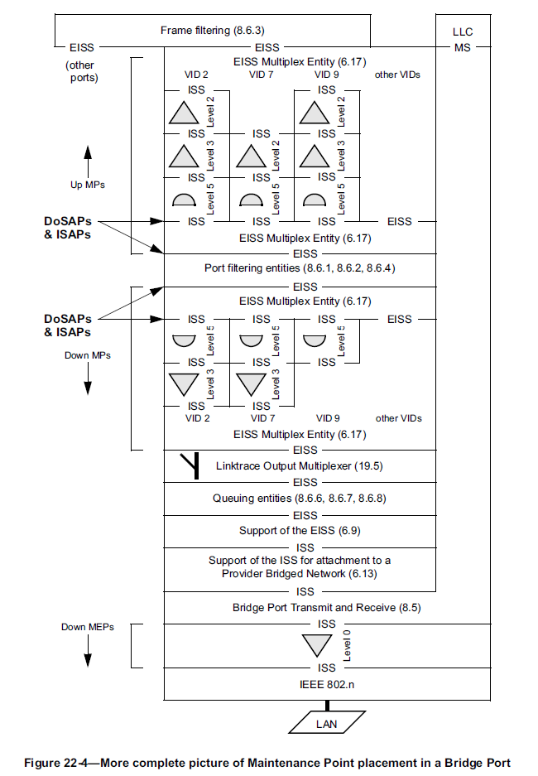
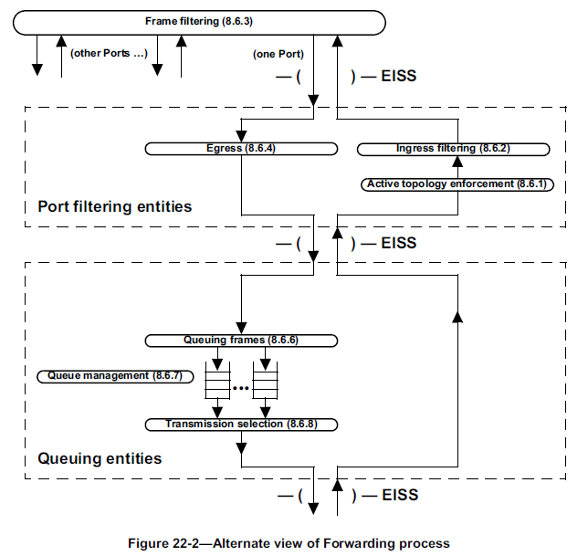
Port filtering entities
Figures 22-2 and 22-4 in 802.1Q illustrate the location of the port filtering entities in a bridge port. How to apply these specifications in the case of a CBP?

Slide 23
Port filtering entities location in CBP?
SVLAN EC Relay
19.2/3/5
19.2/3/5
19.2/3/5
19.2/3/5
SVLAN MEP & MIP
Port filtering entities 8.6.1/2/4
Port filtering entities 8.6.1/2/4
Port filtering entities 8.6.1/2/4
Port filtering entities 8.6.1/2/4
19.2/3/5
19.2/3/5
19.2/3/5
19.2/3/5
SVLAN MEP & MIP
PIP
6.9
6.9
6.9
6.9
6.9
6.9
6.9
6.9
6.9
6.9
6.9
6.9
6.9
6.9
6.9
6.9
6.9
6.9
6.9
6.9
6.9
6.9
6.9
6.9
8.5
8.5
8.5
8.5
8.5
8.5
8.5
8.5
8.5
8.5
8.5
8.5
8.5
8.5
8.5
8.5
8.5
8.5
8.5
8.5
8.5
8.5
8.5
8.5
6.10
6.10
6.10
6.10
6.14
6.14
6.14
6.14
D
SVLAN to BVLAN/TESI muxes
6.14
6.14
6.14
6.14
6.11, 9.5c
ISID
6.11, 9.5c
ISID
6.11, 9.5c
ISID
C
Port filtering entitIes 8.6.1/2/4
BSI Relay
BSI Relay
BSI Relay
ISID
B
6.11, 9.5c
CBP
ISID
ISID
ISID
ISID
ISID
ISID
Port filtering entities 8.6.1/2/4
BSI Relay
19.2/5
A
Port filtering entities 8.6.1/2/4
ISID
ISID
ISID
ISID
ISID
ISID
Port filtering entities 8.6.1/2/4
19.2/5
19.2/5
19.2/5
BVLAN/TESI MEP
BVLAN EC/TESI Relay
Under normal circumstances, the CBPs are Edge Ports for the BVLAN Ethernet connections and TESI connections and port filtering should not be performed; i.e. fixed forwarding (correct?).
In a DRNI Portal with two nodes, BVLAN and TESI endpoints are duplicated (one in each portal node). Should port filtering be used to control which of the two endpoints is connected to a BVLAN/TESI? Or should we instead control the Port Map in the VLAN Registration Entry for BVLANs and the Filtering Entry for TESIs? Or other?
For case port filtering can be used, what is the location of the port filtering entries in the CBP: A, B, C, D or other?
Port filtering may not be the right tool, as BVLAN/TESI MEP functions will generate OAM which is not blocked in case of locations B,C,D. BVLAN and TESI OAM generated by the CBP in the standby gateway node must be blocked.

Slide 24
PBB Domain with G.8031 SNC protected SVLAN EC
G.8031 SNC protected SVLAN EC has active endpoint at either the right, or the left portal node. The other SVLAN EC endpoint is disabled. The two SVLAN EC endpoints form one virtual endpoint.
SVLAN EC P is transported via BVLAN Ug. SVLAN EC W is transported via BVLAN Ub. SVLAN EC N is transported via the Intra-Network BVLAN.
INNI
The Half-DSS functions support the distribution of the SNCP endpoints.
SVLAN EC Relay
SNCP
P
W
BVLAN EC Relay
SVLAN EC P
SVLAN EC W
BVLAN Ub
Intra-Network SVLAN EC N
BVLAN Ug
Intra-Network BVLAN
Intra-DAS BVLAN
BVLAN EC Relay
BVLAN EC Relay
Should S-MAC address of left & right SVLAN EC P/P* MEP be the same?
P
W*
P*
W
Should S-MAC address of left & right SVLAN EC W/W* MEP be the same?
SVLAN EC Relay
DNP Control Protocol
SVLAN EC Relay
Half-DSS
Half-DSS
Half-DAS
Half-DAS
Intra-DAS Link

Slide 25
SNC protected SVLAN EC W & P configurations
State 1:
Working SVLAN EC = EC W
Protection SVLAN EC = EC P + EC N
State 2:
Working SVLAN EC = EC W + EC N
Protection SVLAN EC = EC P
Disabled SVLAN MEP
Active SVLAN MEP
Active SVLAN MEP
Disabled SVLAN MEP
P
W*
P*
W
P
W*
P*
W
Half-DSS
Half-DSS
Half-DSS
Half-DSS
Half-DAS
Half-DAS
SVLAN EC Relay
Half-DAS
Half-DAS
SNCP
SVLAN EC relay
SVLAN EC drop
P
W
SVLAN EC drop
SVLAN EC relay
SVLAN EC P
SVLAN EC W
TESI A drop
BVLAN Ub
BVLAN Ug
Intra-Network SVLAN EC N
Intra-Network BVLAN
P
W*
DNP Control Protocol
P*
W
SVLAN EC Relay
SVLAN EC Relay
Half-DSS
Half-DSS
Half-DAS
Half-DAS

Slide 26
Compound view
Normal state, no failures
B
A
Ub
Ug
U1
B1
A2
B3
A1
B2
U2
BVLAN EC/TESI Relay
A3
BVLAN EC/TESI Relay
hDTS
hDTS
hDTS
hDTS
W
P
P
W*
P
W*
P*
W
P*
W
W
P
P
hDSS
W*
P*
hDSS
W
SVLAN EC Relay
SVLAN EC Relay
Half-DAS
Half-DAS
Intra-DAS
BVLAN or TESI
ENNI
ENNI
hDTS: half-Distributed TESI protection Sublayer, hDSS: half-Distributed SNCP Sublayer

Slide 27
Compound view
Right ENNI failure
B
A
Ub
Ug
U1
B1
A2
B3
A1
B2
U2
BVLAN EC/TESI Relay
A3
BVLAN EC/TESI Relay
hDTS
hDTS
hDTS
hDTS
W
P
P
W*
P
W*
P*
W
P*
W
W
P
P
hDSS
W*
P*
hDSS
W
SVLAN EC Relay
SVLAN EC Relay
Half-DAS
Half-DAS
Intra-DAS
BVLAN or TESI
X
ENNI
ENNI
hDTS: half-Distributed TESI protection Sublayer, hDSS: half-Distributed SNCP Sublayer

Slide 28
Compound view
Right ENNI and Intra-DAS link failure (or right portal node failure)
B
A
Ub
Ug
U1
B1
A2
B3
A1
B2
U2
BVLAN EC/TESI Relay
A3
BVLAN EC/TESI Relay
hDTS
hDTS
hDTS
hDTS
W
P
P
W*
P
W*
P*
W
P*
W
W
P
P
hDSS
W*
P*
hDSS
W
SVLAN EC Relay
SVLAN EC Relay
Half-DAS
Half-DAS
X
X
Intra-DAS
BVLAN or TESI
ENNI
ENNI
hDTS: half-Distributed TESI protection Sublayer, hDSS: half-Distributed SNCP Sublayer

Slide 29
Virtual BVLAN, TESI, SVLAN end points
B
A
Ub
Ug
U1
B1
A2
B3
A1
B2
U2
BVLAN EC/TESI Relay
A3
BVLAN EC/TESI Relay
hDTS
hDTS
hDTS
hDTS
W
P
P
W*
P
W*
P*
W
P*
W
W
P
P
hDSS
W*
P*
hDSS
W
SVLAN EC Relay
SVLAN EC Relay
Half-DAS
Half-DAS
Intra-DAS
BVLAN or TESI
ENNI
ENNI
Virtual SVLAN segment end point P
Virtual SVLAN segment end point W
Virtual BVLAN end point B
Virtual BVLAN end point A
Virtual protected TESI end point B
Virtual protected TESI end point A
Do end points within a virtual end point require a common MAC Address value? Expectation is: yes

Slide 30
MAC Addresses at CBP/PIP ports
To be added…

Slide 31
Impact of single switch fabric?
What will be the impact if an IBBEB has a single switch fabric, which supports both the BVLAN/TESI Relay function and the SVLAN Relay function?
SVLAN Relay
19.2/3/5
19.2/3/5
BVLAN/TESI Relay
Fabric
SVLAN Relay
19.2/3/5
19.2/3/5
19.2/3/5
19.2/3/5
PIP
The same connectivity within a IB-BEB with combined B- & S-VLAN Fabric
6.9, 9.5b
6.9, 9.5b
8.5
8.5
MUX
MUX
MUX
MUX
6.10
6.10
6.14
6.14
6.9, 9.5b
6.9, 9.5b
8.5
8.5
MUX
MUX
MUX
MUX
6.14
6.14
6.10
6.10
6.11, 9.5c
6.11, 9.5c
CBP
BVLAN Relay supports MP BVLAN connectivity between two or more PNPs and one or more CBPs
6.14
6.14
19.2/3/5
19.2/3/5
BVLAN/TESI Relay
6.14
6.14
6.11, 9.5c
6.11, 9.5c
19.2/3/5
19.2/3/5
19.2/3/5
19.2/3/5
6.9, 9.5b
6.9, 9.5b
6.9, 9.5b
6.9, 9.5b
MUX
MUX
MUX
MUX
8.5
8.5
PNP
8.5
8.5
19.2
19.2
19.2
19.2
6.7
6.7
6.7
6.7
802.n
802.n
802.n
802.n
Separate B- & S-VLAN fabrics
Combined B- & S-VLAN fabrics
(combined PNP/CBP/PIP)

Slide 32
Slides added in v2

Slide 33
PBB-TE Domain with TESI segment protection
animated
TESI A1,A2,A3 for protected SVLAN ECs has active segment protected endpoint at either the right, or the left portal node. The other segment protected TESI endpoint is disabled and the associated TESI endpoint is blocked. The two segment protected TESI endpoints form one virtual segment protected endpoint.
TESI U1,U2 for unprotected SVLAN ECs has active endpoints at left and right portal nodes.
INNI
SVLAN EC Relay
TESI B1,B2,B3 for protected SVLAN ECs has active segment protected endpoint at either the left, or the right portal node. The other segment protected TESI endpoint is is disabled and the associated TESI endpoint is blocked. The two segment protected TESI endpoints form one virtual segment protected endpoint.
TESI Relay
W
P
P
W
TESI U1,U2
U2
TESI A with segments A1,A2,A3
B1
TESI B with segments B1,B2,B3
U1
A2
B2
B3
A1
Segment MEP disabled
A3
Segment MEP disabled
TESI A relay
TESI B relay
W
P*
P
W*
W*
P
P*
W
Blocked TESI A endpoint
TESI Relay
Intra-DAS TESI
TESI Relay
Blocked TESI B endpoint
ESP-MAC address of left & right TESI Ui endpoints is different
SVLAN EC Relay
SVLAN EC Relay
ESP-MAC address of left & right TESI A endpoints is the same
ESP-MAC address of left & right TESI B endpoints is the same
Intra-DAS Link

Slide 34
Distributed TESI Segment Protection connected to DRNI
U1
B1
A2
B3
A1
B2
U2
U1
B1
A2
B3
A1
B2
U2
X
A3
A3
W
P*
P
W*
P*
W
W*
P
W
P*
P
W*
P*
W
W*
P
TESI Relay
TESI Relay
SVLAN EC Relay
SVLAN EC Relay
SVLAN EC Relay
SVLAN EC Relay
Half-DAS
Half-DAS
Half-DAS
Half-DAS
X
Intra-DAS TESI
Intra-DAS TESI
X
ENNI
ENNI
ENNI
ENNI
Active Gateway
Standby Gateway
Active Gateway
Standby Gateway
Active Gateway
Active Gateway
Standby Gateway
Standby Gateway
Normal state, no failures
Right portal node failure or ENNI + Intra-DAS TESI failure

Slide 35
Distributed TESI Segment Protection connected to DRNI
U1
B1
A2
B3
A1
B2
U2
U1
B1
A2
B3
A1
B2
U2
A3
A3
W
P*
P
W*
P*
W
W*
P
W
P*
P
W*
P*
W
W*
P
TESI Relay
TESI Relay
SVLAN EC Relay
SVLAN EC Relay
SVLAN EC Relay
SVLAN EC Relay
Half-DAS
Half-DAS
Half-DAS
Half-DAS
Intra-DAS TESI
X
X
Intra-DAS TESI
ENNI
ENNI
ENNI
ENNI
Active Gateway
Standby Gateway
Active Gateway
Standby Gateway
Active Gateway
Standby Gateway
Active Gateway
Standby Gateway
Right ENNI failure
Left ENNI failure

