Slide 1


Empowering Today’s Education to Inspire Tomorrow’s Innovation
Intel® Education Initiative: K-12
Programs of the Intel Education Initiative are funded by the Intel Foundation and Intel Corporation.
Copyright © 2010 Intel Corporation. All rights reserved. Intel and Intel Education are trademarks or registered trademarks of Intel Corporation or its subsidiaries in the United States and other countries. *Other names and brands may be claimed as the property of others.

Slide 2

Improve Teaching
and Learning:
Intel® Teach Program
Preparing teachers for the future with proven, worldwide professional development
  Helps educators integrate technology into lessons to promote 21st century learning
  Wide range of offerings supporting project-based learning in the classroom
  Unparalleled public/private partnership providing flexibility and adaptation
  Independent evaluation supports Intel Teach Program methods
  Most successful program of its kind, training more than 7 million teachers in more than 60 countries
Learn more about the
Intel® Teach Program at:
www.intel.com/education/teach

Slide 3

Our Approach:
A Public/Private
Collaboration
  Committed partners
    Government
    Educators
    Community
    Development agencies
    NGOs
  Local alignment and expertise
Notes:
We strive to work together with educators and governments around the world to improve teaching and learning. We collaborate with governments, educators and leading institutions in every community in which we have a presence.
We also recognize the expertise and reach of multilateral development organizations like UNESCO. In November 2004, we signed an MOU with UNESCO around the creation of a worldwide framework for teacher training in the use of ICT to build 21st century skills in today’s students.
We recognize that educators are the key to improving how students learn, thus the Intel® Education Initiative offers programs in collaboration with these educators.
Creating localized programs is critical to the success of an international initiative. So while our programs and resources are available in more than 60 countries, they are localized to meet the language and cultural needs of each community.

Slide 4

Intel® Teach
Evaluation
Third party evaluation key to program success
  Independent global evaluation by EDC
  Evaluation results used to continuously improve program delivery
Evaluation results:*
  91% of teachers said students were “motivated and involved in the lesson”
  81% of teachers reported that “student projects showed more in-depth understanding” than other, comparable work
  75% of teachers integrate technology in new ways after the training
  61% of teachers increase their use of project-based approaches in their teaching
Learn more at:
www.intel.com/education/k12
  *Source: EDC International Impact Survey Results, July 2006.
Notes:
Independent evaluation results show that the program is having a measurable impact. Find this and other 3rd party evaluation reports on the Intel Education Evaluation Site, accessible from www.intel.com/education/k12
Globally, the program has strong success rates across four indicators.
91% of teachers said students were “motivated and involved in the lesson”
81% of teachers reported that “student projects showed more in-depth understanding” than other, comparable work
75% of teachers integrate technology in new ways after the training
61% of teachers increase their use of project-based approaches in their teaching

Slide 5

Enhanced Core
Standards & Assessment
Integration of Technology
Thinking Tools
Language Arts
Educational
Software
Summative Assessment
Web-based communities
Social
Science
Portfolio
Performance
Blogs
Intel
Teach
Science
Wikis
Social
Media
Formative Assessment
Productivity Tools
Math
Peer
Assessment
Webinars
21st
Century Skills
Intel® Teach
Self-
directed learning
Free professional development for K-12 teachers focused on integrating technology and 21st century skills into their
lessons.
Communication
Innovation
Collaboration
Creativity
Leadership
Problem solving
Critical
Thinking
Use of
media
Visualization of
Information

Slide 6






Intel® Teach Program Portfolio
For K-12 Classroom Teachers, All Subjects – Free Online or on CD, Anywhere/Anytime
Intel Teach Elements Courses
A series of high interest, visually compelling short courses online or on CD that provide deeper exploration of core Intel Teach learning concepts. Project-Based Approaches and Assessment in 21st Century Classrooms available now – Collaboration in the 21st Century Classroom coming summer 2010.
ICT Teachers
Skills for Success Course
Training on a student curriculum that develops digital literacy, problem solving, critical thinking, and collaboration skills.
K-12 Classroom Teachers, All Subjects
School Leaders
Leadership Forum
Network with other leaders to focus on leadership in promoting, supporting, and implementing effective technology integration in schools.
Essentials Course
Develop units that integrate technology into existing classroom curricula to promote student-centered learning.
Getting Started Course
Introduction to classroom software productivity tools and student-centered approaches to learning.
Essentials Online Course
Develop units that integrate technology into existing classroom curricula to promote student-centered learning in an Online Course.
Advanced Online Course
Collaborate with other teachers to build communities to advance integration of technology and 21st century learning.
Thinking with Technology Course
Develop project-based units using online thinking tools to enhance students’ higher-order thinking skills.
Course Overview
Course Overview
Course Overview
Course Overview
Course
Overview
Course Overview
Intel® Education Online Tools and Resources
Help Guide, Assessing Projects, Designing Effective Projects, Thinking Tools…
www.intel.com/teachers

Slide 7

Getting Started Course
  Training for K-12 In Service and Pre Service Teachers with little or no technology experience
  Focus: Introduction to integrating technology, project-based approaches, and 21st century learning into the classroom
  Teacher benefits:
    A fully developed action plan
    New strategies for enhancing teacher productivity
    Additional resources, including a books, articles, Web sites, and colleagues

Slide 8
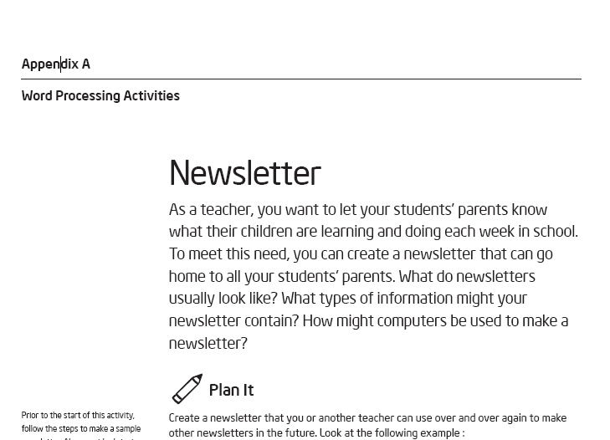
Getting Started: Sample activity
Activities:
    Designed to support teacher productivity
    Structured so teachers learn by doing
    Supported with materials that role model how technology can be used with students

Slide 9

Skills for Success Course
  Training for Computer Teachers in a computer lab environment
  Focus: Training on a student curriculum that develops 21st century learning
  Teacher benefits:
    A fully developed student curriculum
    New strategies for developing a 21st century learning environment
    Local community and work-themed activities

Slide 10
Skills for Success Course
  Training for Computer Teachers in a computer lab environment
  Focus: Training on a student curriculum that develops 21st century learning
  Teacher benefits:
    A fully developed student curriculum
    New strategies for developing a 21st century learning environment
    Local community and work-themed activities

Slide 11
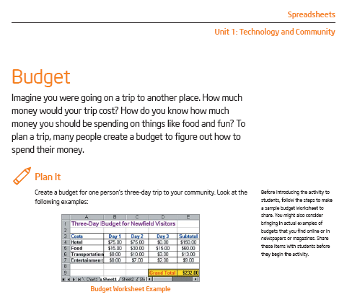
Skills for Success: Sample
Activities:
    Designed to support teacher mediated ICT classes
    Structured so students learn by doing
    Support outcomes in Digital Fluency, Problem solving and Collaboration

Slide 12

Essentials Course / Essentials Online*
  Training for Teachers with basic knowledge in project-based approaches and intermediate skills in computer applications
  Focus: Create a foundation of skills to fully integrate technology into existing classroom curricula and promote student-centered learning
  Teacher benefits:
    New strategies for facilitating student-centered classrooms that encourage student self-direction and higher-order thinking
    Opportunities to collaborate with colleagues to improve instruction
    Ability to develop unit plans using technology to support 21st century teaching and learning
    Free curriculum materials, including sample unit plans, useful Web sites, help guide, and Assessing Projects application (rubrics, checklists, and scoring guides to measure 21st century skills)
* Course can be delivered face-to-face or a hybrid of face-to-face and online

Slide 13
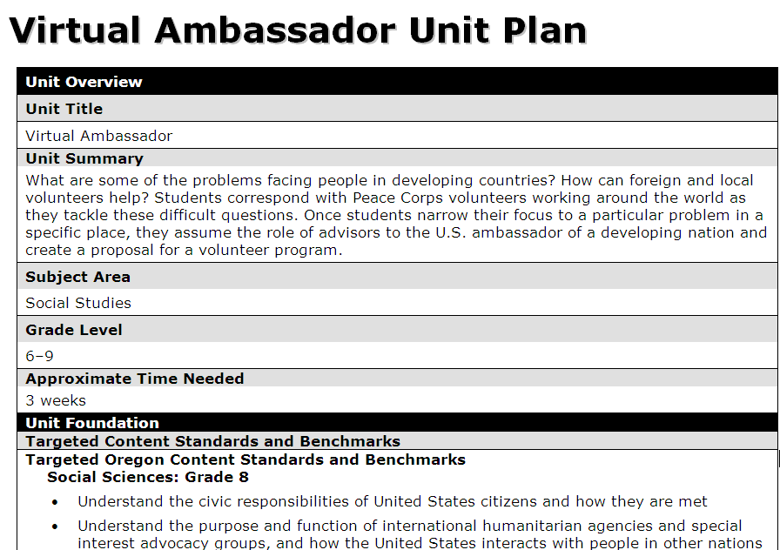
Essentials: Sample Unit Plan for Teacher
Units:
    Student centered learning
    Using curriculum framing questions
    Require students to solve problems, think critically, collaborate and communicate
Notes:
The Essentials course aims to help teachers use the power of computer technology to spark student imagination and ultimately move them to greater learning. Goal is to train classroom teachers how to promote student centered learning and effectively integrate the use of computers into their existing curriculum so that students will increase their learning and achievement.

Slide 14
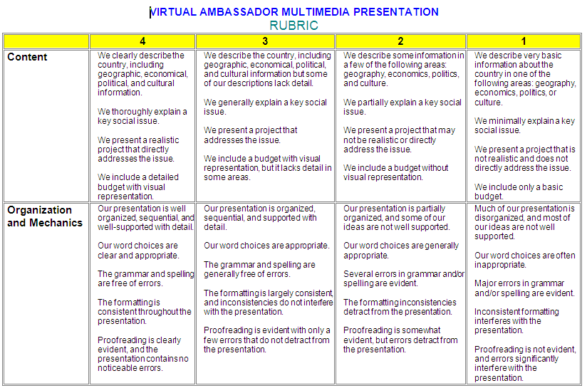
Student Assessment Tools for Teachers
Notes:
The course is grounded with strong evaluation tools that can help guide the content and design of all that is taught in the classroom. Guided by these evaluation tools, teachers can expand the possibilities for learning in the classroom by using the computer for research, publishing, and communication.
This evaluation matrix shows the range of student skills and their attributes, in this example focusing on content and presentation skills.

Slide 15

Thinking with Technology Course
For K-12 teachers in all subjects with an intermediate level of technology integration skills
Focus: Advanced training on assessing and promoting 21st century learning
Teacher benefits:
  Strategies and project ideas for using online thinking tools to target and assess higher-order thinking skills
  A fully developed Unit Plan, aligned to their local standards, which incorporates one or more thinking tools
  Free curriculum materials and classroom resources, including sample unit plans, useful Web sites, and online tools: Visual Ranking Tool, Seeing Reasoning Tool, and Showing Evidence Tool

Slide 16
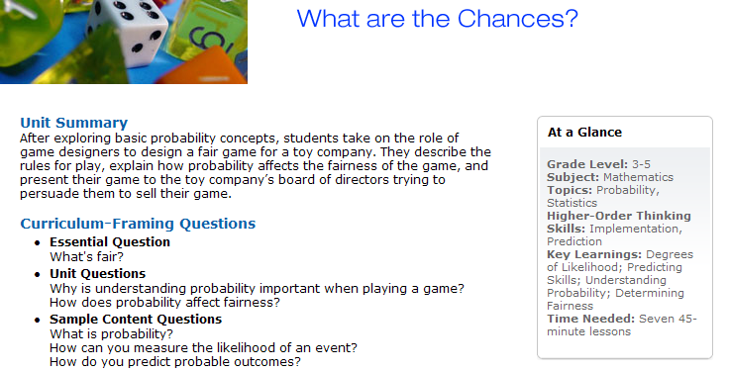
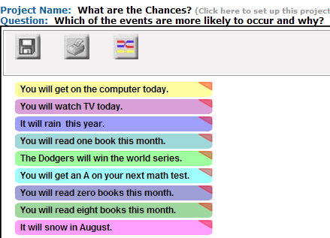
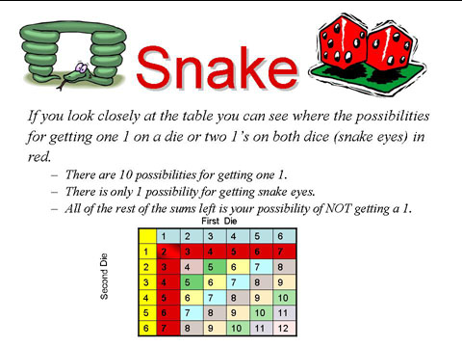
Teaching Thinking with Technology
Notes:
Thinking with Technology helps teachers learn how to integrate into their curriculum unique online thinking tools that are designed for students to visually represent their understanding of complex and interconnected issues.
Here teachers use online tools that have students prioritize and compare lists, investigate cause and effect relationships, and build well-structured arguments.
Teachers learn instructional strategies for addressing and assessing thinking skills using technology to increase opportunities for effective student collaboration, student-teacher interactions, and the inquiry process.
Teachers create a unit plan and sample projects that are aligned to their state standards and support a project approach to learning and authentic inquiry.

Slide 17

Advanced Online Course
  For teachers with basic skills in integrating technology in the classroom
  Focus: Through a blend of face-to-face and online training, teachers form communities to advance their integration of technology and student-centered learning
  Teacher benefits:
    Introduction to a range of technologies to integrate in the classroom
    Strategies for using technology to promote collaboration and improve learning based on students different learning styles
    Methods to teach students basic skills on using different technologies to support learning
    Free Web resources: teachers discussion forum, unit plans, project ideas, and materials

Slide 18

Leadership Forum
  For school leaders who want to advance 21st century learning
  Focus: Gives school leaders the skills to support, promote, and implement technology into the classroom
  Leader benefits:
    Awareness of how leadership behaviors is impacting integration of technology in the classroom
    Understanding the importance of leadership responsibilities associated with national and international standards
    Development of a personal action plan
    Free Resource CD: case studies, relevant research, and more

Slide 19

Intel® Teach Elements
Convenient just-in-time professional development for busy teachers
Compelling e-learning content, including animated e-learning tutorials, interactive learning exercises, and offline activities.
Free online or off CD
Available Courses
Project-Based Approaches
Assessment in 21st Century Classrooms
Future Courses Include:
Collaboration in the Classroom (featuring Web 2.0)
Thinking Critically with Data (Displaying and Interpreting Data visually)
Self-Directed Learning in a Student-Centered Classroom

Slide 20

Intel® Teach Elements: Assessment in 21st Century Classrooms
Follow three teachers who are implementing embedded and ongoing assessment methods in their classrooms
See assessment in action in 21st century classrooms
Learn about purposes, methods, and instruments for assessment
Understand how to integrate assessment methods
Plan and develop assessments
Support and manage ongoing assessment and data
Notes:
>> Launch the course and show the Orientation and scroll through the Introduction.
[TO PRESENTER: If you have time, do one activity

Slide 21


Intel® Teach Elements: Project-Based Approaches
An experienced teacher mentors her colleague, sharing her strategies to engage students in projects that enhance their learning.
You’ll visit students to see how they’re
benefiting from Project-Based Approaches.
Notes:
>> Launch the course and show the Orientation and scroll through the Introduction.
[TO PRESENTER: If you have time, do one activity: A good one is Module 1: Lesson 2 (PBL Benefits, Misconceptions & Challenges: Maria’s advice to Abe). You can jump straight into an activity (you probably know this) by clicking the Menu button at the bottom of the page, then select (this one is Mod 1, Lesson 2, activity 3)]

Slide 22

Classroom Tools and Resources
The Intel® Education Web site includes free content, interactive tools, and other useful resources for educators such as:
  Designing Effective Projects (includes unit plans and project ideas)
  Interactive Thinking Tools
  Innovation Odyssey
  Assessing Projects
  Journey Inside
  skoool™ Interactive Learning
  http://www.intel.com/teachers
Programs of the Intel® Education Initiative are funded by the Intel Foundation and Intel.
Copyright © 2008, Intel Corporation. All rights reserved. Intel, the Intel logo, Intel Education Initiative, and Intel Teach Program are trademarks of Intel Corporation in the U.S. and other countries. *Other names and brands may be claimed as the property of others.

Slide 23
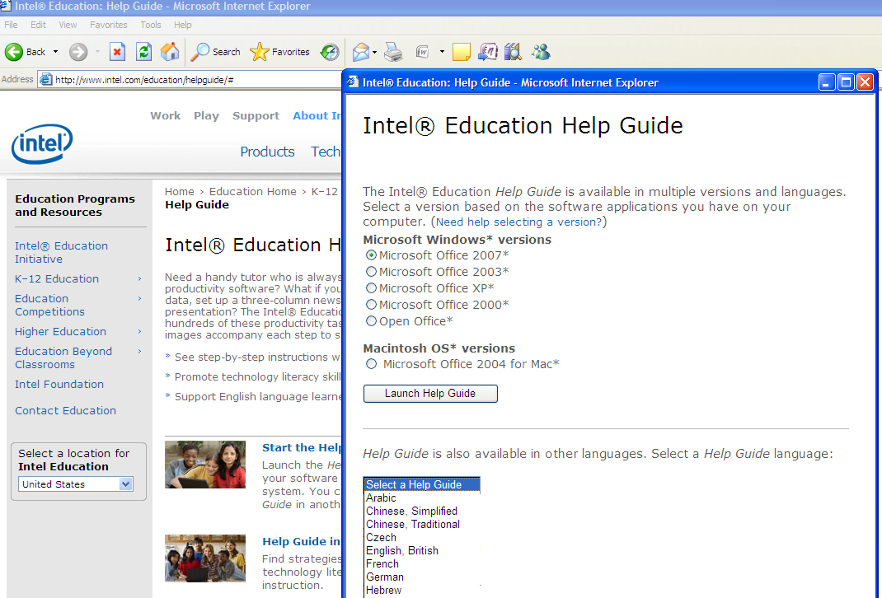
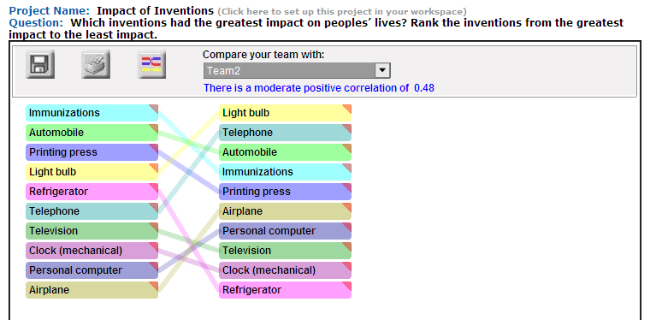
Education Content - Online Tools / Teacher Workspace
Teachers develop technology-rich lessons for students
Thinking Tools (Visual Ranking, Seeing Reason, Showing Evidence) and Help Guide.
Teacher-mediated, customizable projects and resources: teachers bring their content into the open-ended tools, save their projects and send student teams into the tools to work.
      Designed for K-12 teachers of all subjects.
      Based on research that demonstrates the value of visual representation in constructing and retaining new information.
23

Slide 24
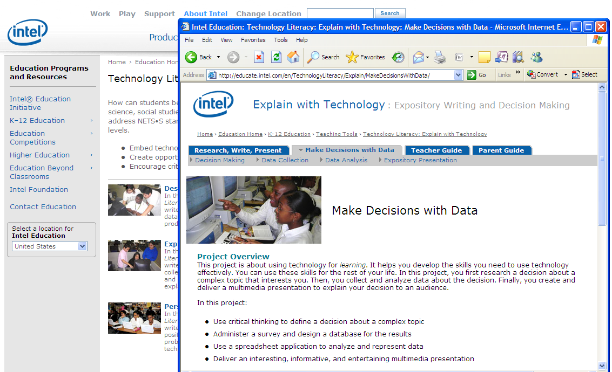
Education Content - Teacher Resources for 21st Century Skills
Online resources model effective technology use in teaching & learning – ready to use or to adapt:
Designing Effective Projects, Assessing Projects, Design and Discovery, Technology Literacy

Slide 25
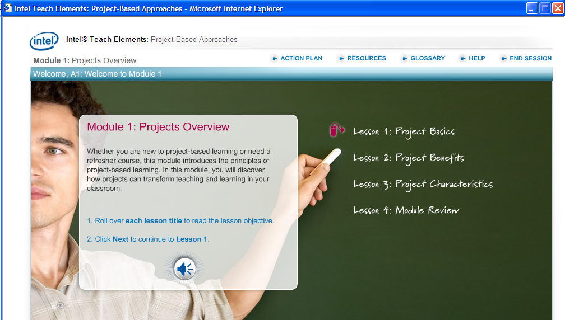
Education Content - Online Professional Development Courses
Model effective technology use in teaching & learning
      Intel Teach Essentials Online uses “Moodle”, a Course Management System designed for education and fostering collaboration
      Intel Teach Elements series uses the Intel University templates for a visually compelling, interactive course experience – available to anyone, anytime
Provide opportunities for teachers to practice in an online course environment (they prepare to facilitate)

Slide 26
How our Train the Trainer Model Works
Expanding
Student Reach
200-1000 Participant Teachers
(PT)
20
Master Teachers (MT)
Senior Trainer (ST)
Replicable Model
  Builds local leadership
  Drives positive systemic impact through
    Sustained trainer support
    Structured approaches
    Consistent evaluation

Slide 27

“Compared to the other information technology companies doing international work in support of education reform, Intel is the world leader. Intel has both extensive world-wide reach and a comprehensive vision for education reform in support of 21st century teaching and learning.”
- Robert Kozma, Ph.D.
Notes:
Intel’s sustained philanthropic commitment delivers programs that improve teaching and learning through the effective use of technology; advance math, science, and engineering education; and enable cutting-edge research
Intel helps education leaders build a more competitive future by using technology to support new teaching and learning methods. Technology-based 21st century education represents a transformation of the education experience that will in turn transform lives
Intel aims to better equip teachers to help students to develop the technology literacy, critical-thinking, problem-solving and collaboration skills needed for success.

Slide 28

A Leading Corporate
Citizen
Intel contributes to our global communities through robust programs in:
  Education
  Environmental Health & Safety
  Leadership in our site communities
  www.intel.com/education/K12
Download the latest version of this presentation

