Slide 1




Action Plan
Vietnam
Intel ISEF 2010
Educator Academy
May 2011
1
1
Intel Confidential

Slide 2

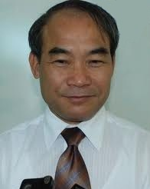
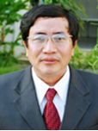
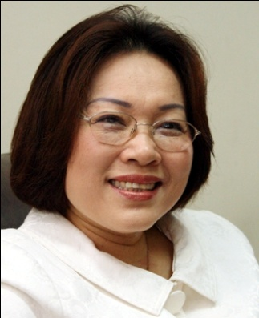
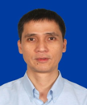
Vietnam - Introductions
  Mr. Nguyen Vinh Hien
  Deputy Minister
Ministry of Education and Training (MOET)
Mr. Vu Dinh Chuan
Head of Secondary
Education
Department
MOET
  Mrs. Nguyen Thi
  My Loc
  Principal
  University of Education, Vietnam National University
Mr. Nguyen Thuong Hai
Education Manager
Intel Vietnam.

Slide 3
Science Talent Student Development in Vietnam
Overview
  75 gifted high schools (GHS): Math, Literature, Physics, Chemistry, Biology, ICT,..
  The GHS use special curricula, textbooks and education methodology under MOET supervision
  Vietnamese students have good results in International Olympic competition
Budget (period of 2010-2020): 110.663 million US$, in which:
  ODA: 45.629 million US$
  Local : 3.052 million US$
  State : 61.982 million US$

Slide 4
High Level Goals
What do you want to accomplish for your school, region or country? Look at long-term (3-5 years) and short-term goals (1-2 years)
    Long term goals
      Implement science inquiry in secondary schools. Change the ways teachers teach & students learn & research science.
      Institutionalize management of science fairs and science programs for primary and secondary schools
      Increase the number of students participating in science fairs by 50% within 3 years
    Short term goals
      MOET plays the charing role in organizing Intel ISEF in Vietnam
      University of Education (VNU) plays the role of national SRC & IRB
      Establish a bank of mentors to assist students
      Improve scientific review and judging

Slide 5
Objectives
How will you know you succeeded?
Please list the results you want to see
  1 or 2 more provinces/cities participate in the National Intel ISEF Affiliated Fairs.
  Schools, students (about 30k) participation in Affiliated Fairs increases 50% over a three-year period.
  Volunteers/mentors increases 15% during the 2011-2012 school year.
  Improvements of the projects’ quality.
  Systemic curriculum changes underway; 6,500 teachers trained in Project Based Learning in 2011.
  Science research becomes formal activities of the school year.
  MOET & Local DOETs plan budget to support the Science research.

Slide 6

Action Plan
Action | Measure success? | Who’s Responsible? | Dead- line?
Submit general plans for Intel ISEF 2012 | The possibilities of submitted plans | MOET, University of Education Participating DOETs | June 2011
Do PR work to promote the Intel ISEF to create awareness for the public | - The numbers of newspapers covers through out country. - Promote through the Teachers Online Community (# of hits). | Participating DOETs (Hue, Quang Tri, HCMC, Lam Dong ) Intel/RTA | On-going On-going
Introduce Intel ISEF to more provinces, cities, schools | The numbers of provinces, cities participate in Intel ISEF Affiliated fair | MOET, University of Education Participating DOETs Intel/RTA | On-going
Invite specialists/lecturers or send guests to other countries doing well with Intel ISEF to share/learn | The impacts of the trainings | Intel/RTA | July 2011
Organize training Workshops for Teachers & Students on Science Research | - 5,000 teachers - 30,000 students | MOET, University of Education Participating DOETs Intel/RTA | Q3, 2011
Establish Schools SRC & IRB | Numbers of participating schools | Participating DOETs | Sep 2011
Training Workshop for Country wide SRC & IRB | 8 provinces in proximity | MOET, University of Education Participating DOETs Intel/RTA | Oct 2011
Work with various Donors for supports | Youth Org, Nuclear Institute, Dell, HP, Lawrence Sting Fund… | Participating MOET | On going

Slide 7
Intel ISEF Educator Academy
Reflection:
As a result of your participation in the 2011 Educator Academy, reflect on your experience Highlight what your team felt was the key learning from the Educator Academy:
  an wonderful opportunity to refresh training on Intel ISEF through attending Shop Talks.
  Learned and shared experiences on how to improve local Intel ISEF Fair.
  Opportunity to check what students
What impressed you the most?:
  Opening ceremony.
  Quality of the shop talks.
  Curriculum day.
  The organization of all the event.

Slide 8
Intel ISEF Educator Academy
Reflection:
Which Shop Talks were the most beneficial for your team?:
  Russ Fisher-Ives
  Cora beth Aben
  Robert Yost.
  Jack Franchetti.
  Sergi Mosyakin
  SRC Panel.
  Sharon/Karen shop talk
  Intel ISEF Students Panel.
What would you improve:
  Follow 3 steps to systemic improvement of science education and increase # of schools participation.
  Improve the inquiry science in schools.
  Students to present themselves and deal effectively with media.

Slide 9


