Slide 1

Intel World Ahead Program
Digital Technologies for Increasing Capacity and
Enabling the Healthcare Workforce Globally

Slide 2
TERMS OF DISCLOSURE
DELETE THIS SLIDE BEFORE
PRESENTING
THE FOLLOWING PRESENTATION MATERIALS AND ANY RELATED CONTENT IS INTEL CONFIDENTIAL AND SHOULD NOT BE LEFT BEHIND IN HARD COPY OR ELECTRONIC FORMAT WITH CUSTOMERS OR 3RD PARTIES. THIS INCLUDES ACCESS TO INTEL DEMO WEBSITE.
EXCEPTIONS: CUSTOMER OR 3RD PARTY INTEL NDA IS IN PLACE PLEASE SEND YOUR REQUESTS TO SHARE MATERIAL TO CONTACTS BELOW AND STATE BUSINESS REASONS.
SOLUTION DESCRIBED HEREIN IS UNDER DEVELOPMENT & SUBJECT TO CHANGE AND THUS INTEL ACCEPTS NO LIABILITY. SEE INTEL LEGAL DISLCAIMER SLIDE.

Slide 3
Intel Legal Disclaimer
EXCEPT AS PROVIDED HEREIN, THE SOFTWARE AND MATERIALS ARE PROVIDED "AS IS" WITHOUT ANY EXPRESS, STATUTORY OR IMPLIED WARRANTY OF ANY KIND INCLUDING, BUT NOT LIMITED TO, WARRANTIES OF SATISFACTORY QUALITY OR MERCHANTABILITY, NONINFRINGEMENT, FITNESS FOR A PARTICULAR PURPOSE OR ANY WARRANTY OTHERWISE ARISING OUT OF ANY PROPOSAL, SPECIFICATION OR SAMPLE.
Intel does not warrant or assume responsibility for the accuracy or completeness of any information, text, graphics, links or other items contained within the Software and Materials. Intel shall not provide any updates or new revisions and shall have no obligation to provide any support or maintenance for the Software and Materials. Should Intel revise the Software and Materials it is under no obligation to provide any notice or updates of such revisions. Intel neither assumes nor authorizes any person to assume for it any other liability
Intel Confidential

Slide 4

Connecting the next billion people to a world of opportunity
Intel World Ahead Program promotes access to technology that helps enrich people’s lives and stimulate economic opportunity.
Notes:
The Intel World Ahead Program accelerates access to technology
that helps enrich people’s lives and stimulate socio-economic
opportunity. Intel helps connect millions of people each year to
appropriate technologies, high-speed connectivity, education
and healthcare improvements, and digital content that helps
them achieve sustainable social and economic gains.
Intel collaborates with governments, telecommunications providers and other technology
companies, financial institutions, healthcare institutions, and non-governmental organizations
to do this important work. The result is comprehensive, long-term approaches for
enabling citizens to acquire 21st century skills and participate in the global economy.

Slide 5




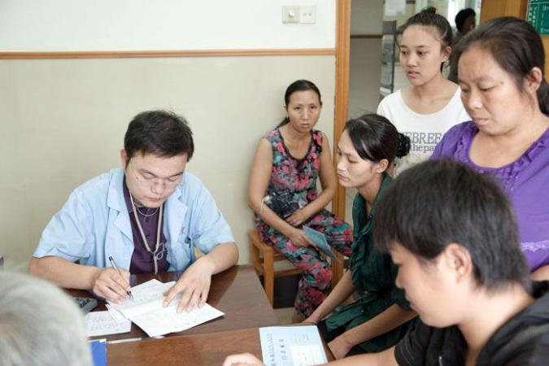
Intel World Ahead Program: Pillars
Access
Connectivity
Education
Content
PCs
Usage Model
Affordability
Shared Access
Telco and Cable
Broadband
WiMAX
Wi-Fi
21st Century Skills
Technology solutions
Education programs
e.g. 4M teachers trained
e-Services
Localized digital content
ICT skills
Healthcare
Notes:
Intel focuses on five key areas:
• Access: Accelerating technology access and usage in underserved communities
• Connectivity: Connecting the world with broadband technologies
• Education: Preparing students for new opportunities
• Digital Content and Services: Enabling information, applications, and services
that improve lives and opportunity
• Healthcare: Advancing healthcare where it’s needed most
Intel shares tools, technologies, content, and expertise to promote development of localized content that enhances lives, expands opportunities, and enables new service delivery models

Slide 6
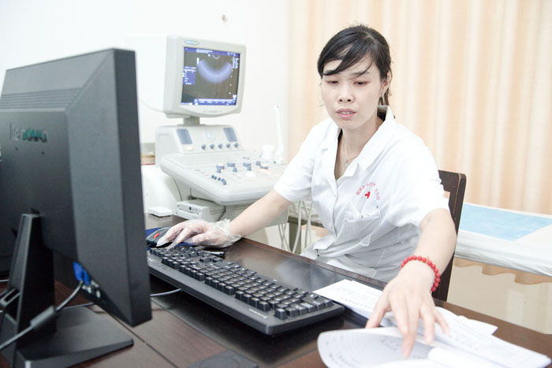

Healthcare
Improving Access to healthcare where it’s needed most
  Providing access to new medical technologies, methodologies, and information
  Enabling ICT tools for capacity & 21st Century skills building for Healthcare workforce
  Collaborations with governments, developing communities and private sector

Slide 7
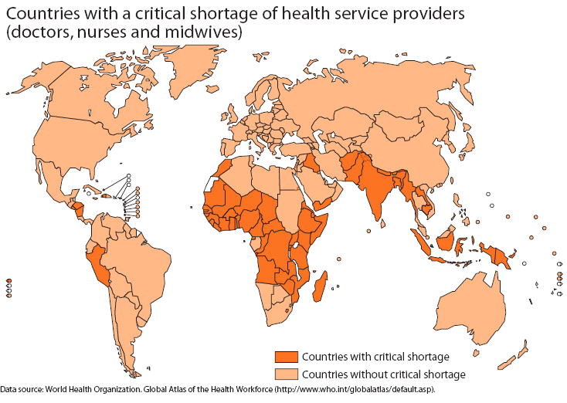
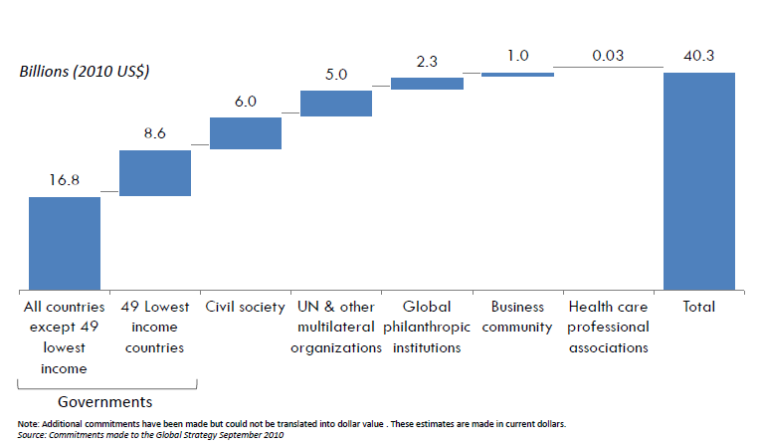

Healthcare Workforce Shortage
A Major Problem
Challenges: Critical shortage of healthcare workforce in 57 developing countries across the continuum – doctors, nurses, midwives and frontline health workers
Limited Faculty and Facilities
Access, Quality, Cost of Training
High mortality rates of maternal, infant and child health
Socio-economic development
57 Developing countries with critical shortage
of health workforce
$40B + Investment to accelerate MDG’s goals 4, 5
Little progress in Africa, insufficient in Asia
Maternal mortality ratio still very high
Notes:
Critical shortages exist in 57 developing countries est. 4.5m (source:WHO)
International comparison of Physician and Nursing rations per 100,000 population (original source WHO)
Global Comparison: Physicians 170:100,000, Nurses 399:100,000
In these Developing countries: Physician ratio anywhere from 3:100,000 to 51:100,000
In these Developing countries: Nursing Ratio anywhere from 24:100,000 to 79:100,000
Under-five mortality:
little progress in Africa, insufficient in Asia
Maternal mortality ratio still very high
There is an estimated shortage of some 4.5m health workers in 57 developing countries around the world with particularly severe shortages. This is a huge factor, negatively impacting socio-economic development of these countries. In Sub Sahara Africa there is a shortage of 1m health workers. In Indonesia an approx shortage of 380k nurses.
Huge limitations exist – faculty, equipment, access to high quality training and assessment of skills. ICT has a huge role to play in bringing 21st century skills into developing countries to help modernize healthcare system by improving skills/quality and increase capacity.
Limited capacity to train more – Faculty, Facilities
Huge negative impact on socio-economic development
High Maternal, Infant, Child Mortality in many
Cost, quality & access big issues to healthcare education & training

Slide 8
Intel® 1Mx15 Health Program
Unleashing the potential of Digital Technologies to Increase Capacity
and Enable the Healthcare Workforce in Developing Countries
Intel® 1Mx15 Health Program
Education
Healthcare
Sales Programs
Sales Programs
Enable 1M+ healthcare workers in developing countries with technology,
education tools and 21st century ICT skills by 2015
Notes:
ICT has huge potential to help address capacity building and skills of healthcare workforce in Developing Countries
Intel® 1Mx15 Health Program -
Vision: Enable at least one million front-line healthcare workers with technology, education tools, and 21st century ICT skills to accelerate progress towards UN MDG’s for women’s and children’s health
Objective: Collaborate with governments, private industry, development community, and academia to establish country programs to increase the availability, affordability and usage of computers, broadband, and education tools
Intel ICT based Tools incl. 21st Century skills enabling incl. a new Digital Health Education and eLearning delivery platform to Enable Technology Accessibility to at least One Million Healthcare Workers in Developing Countries by 2015 to help build workforce capacity, access, standards and 21st Century skills
Objective: Collaborate with governments, private industry, development community, and academia to establish country programs to increase the availability, affordability and usage of computers, broadband, and education tools
Executive Sponsor: John Davies, VP World Ahead Program
Target: Empower at least 1M healthcare workers with technology skills and education tools by 2015 (but also help build greater capacity for education & learning to enable new healthcare students……….
Program Elements:
Intel skoool for Health Education Platform – multi-media education and delivery platform with assessments that can be used on-line and off-line
Intel PC Basics Learning Program – Basic ICT Skills
Intel PC Purchase and Broadband Programs – To help drive scale with Govt. support as an example (GAPP, suported by Government), USF etc.
Grameen-Intel Social Business Solutions – sustainable solutions for tracking high risk pregnant mothers and vaccination tracking for instance in newborms, under 5 years.
Intel Social and Ethnographic Research to meet the needs of existing and new wave of healthcare students
UK British Council English Learning Platform – major requirement in many developing nations
NEWS HIGHLIGHTS
Introduces Intel's 1Mx15 Health Program which will bring technology training to 1 million healthcare workers in developing countries by the end of 2015
Includes the Intel Skoool™ Healthcare Education Platforms that provides anytime anywhere multimedia content delivery and an assessment platform
Sri Lanka will be the first country to take part in Intel's 1MX15 Health Program and adopt the Intel Skoool™ Healthcare Education Platform
2015 goal is in support of the UN Global Strategy to improve Maternal, Infant and Child Health (UN MDG’s 4,5)
New York, Sept. 23, 2011 – Intel® announced the 1Mx15 Health Program which will bring ICT training to one million healthcare workers in developing countries by the end of 2015. The program will enable healthcare workers with technology, education tools and 21st century ICT skills to help accelerate progress toward better health primarily for women and children. In collaboration with governments, private industry, development communities and academia the program will establish various country initiatives to increase the availability, affordability and usage of computers, and broadband.
As part of this program, Intel created The Intel Skoool™ Healthcare Education Platform that provides an anytime anywhere multi-media content delivery and assessment platform. The platform is designed to help the need for health education and capacity building of the healthcare workforce in developing countries. It will have an open access license with no charge.
Sri Lanka will be the first country to deploy the Intel Skoool™ Healthcare Education Platform designed for the educational needs of healthcare workers and students in their country.
"Sri Lanka has taken some unique steps that other countries could emulate," said the government of Sri Lanka. "Some of these projects have already commenced at grassroots level through collaborations with industry partners such as Intel."
John Davies, Intel Vice President of the World Ahead Program said, "We are very excited to support the UN Nation's Every Woman, Every Child Initiative and believe that our 1Mx15 Health Program and the Intel Skoool™ Healthcare Education Platform will help governments address the training needs of their healthcare workforce. We believe a well-trained healthcare workforce will enable better access to quality healthcare for women and children."

Slide 9

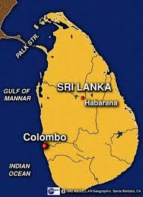

Intel® 1Mx15 Health Program
Unleashing the potential of Digital Technologies to Increase Capacity
and Enable the Healthcare Workforce in Developing Countries
as the key enabling platform
Provide education, training and assessment to 100,000 workforce using the Intel skoool™ Healthcare Education Platform
Training and certifying the 100,000 workforce on ICT skills by 2015
Help enable affordable p.c. purchase programs with access incl. low cost broadband
Implementing a basic electronic health record for children in 5000 schools by 2015
SRI LANKA
Notes:
ICT has huge potential to help address capacity building and skills of healthcare workforce in Developing Countries
Intel® 1Mx15 Health Program which will bring ICT training to at least one million healthcare workers in developing countries by the end of 2015
New Health Education and Learning Program to Enable Technology Accessibility to One Million Healthcare Workers in Developing Countries by 2015
Objective: Collaborate with governments, private industry, development community, and academia to establish country programs to increase the availability, affordability and usage of computers, broadband, and education tools
Executive Sponsor: John Davies, VP World Ahead Program
Target: Empower at least 1M healthcare workers with technology skills and education tools by 2015
Program Elements:
Intel skoool for Health Education Platform
Intel PC Basics Learning Program
Intel PC Purchase and Broadband Programs
Grameen-Intel Social Business Solutions
Intel Social and Ethnographic Research
UK British Council English Learning Platform
This includes
NEWS HIGHLIGHTS
Introduces Intel's 1Mx15 Health Program which will bring technology training to 1 million healthcare workers in developing countries by the end of 2015
Includes the Intel Skoool™ Healthcare Education Platforms that provides anytime anywhere multimedia content delivery and an assessment platform
Sri Lanka will be the first country to take part in Intel's 1MX15 Health Program and adopt the Intel Skoool™ Healthcare Education Platform
2015 goal is in support of the UN Global Strategy to improve Maternal, Infant and Child Health (UN MDG’s 4,5)
New York, Sept. 23, 2011 – Intel® announced the 1Mx15 Health Program which will bring ICT training to one million healthcare workers in developing countries by the end of 2015. The program will enable healthcare workers with technology, education tools and 21st century ICT skills to help accelerate progress toward better health primarily for women and children. In collaboration with governments, private industry, development communities and academia the program will establish various country initiatives to increase the availability, affordability and usage of computers, and broadband.
As part of this program, Intel created The Intel Skoool™ Healthcare Education Platform that provides an anytime anywhere multi-media content delivery and assessment platform. The platform is designed to help the need for health education and capacity building of the healthcare workforce in developing countries. It will have an open access license with no charge.
Sri Lanka will be the first country to deploy the Intel Skoool™ Healthcare Education Platform designed for the educational needs of healthcare workers and students in their country.
"Sri Lanka has taken some unique steps that other countries could emulate," said the government of Sri Lanka. "Some of these projects have already commenced at grassroots level through collaborations with industry partners such as Intel."
John Davies, Intel Vice President of the World Ahead Program said, "We are very excited to support the UN Nation's Every Woman, Every Child Initiative and believe that our 1Mx15 Health Program and the Intel Skoool™ Healthcare Education Platform will help governments address the training needs of their healthcare workforce. We believe a well-trained healthcare workforce will enable better access to quality healthcare for women and children."

Slide 10
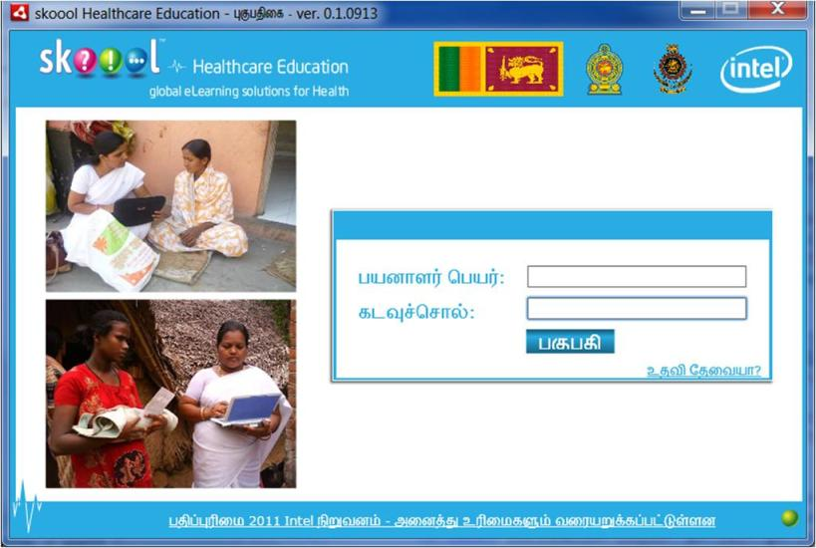
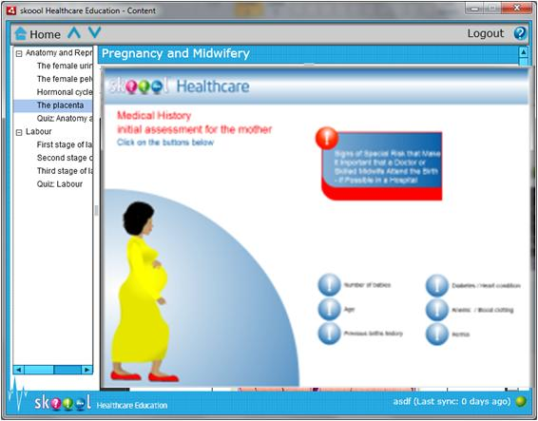
Mobile PC app enables eLearning and assessment with or without the Internet
Delivers multimedia content (html, video, flash, audio, pdf) and assessments to verify understanding
Web server supports course content upload, assignment & results tracking
Content sourced from 3rd Parties subject matter expert s (e.g. Non for Profits,
NGOs)
Notes:
The Intel skoool™ Healthcare Education Platform comprises of both a client and server application. The client application runs currently runs on Microsoft Windows™, and enables access to digital curriculum material and health worker assessments on-line and off-line. The server application consists of a LAMP (Linux/Apache/MySql/PhP) stack that enables ministries of health and higher education to deliver aggregate content into course modules, assign those modules to user roles via programs with due dates, and to track assessment results on group and individual levels.
The skoool™ Healthcare Education Platform enables import of existing content in formats such as html, Adobe Flash™ and Adobe PDF™, and video, as well as javascript-based assessments
The Intel skoool™ Healthcare Education Platform has been designed to facilitate and scale capacity building in the health sector, starting with but not limited to front-line health workers and students. The 1st initial focus is the front line, community healthcare workforce. It is also designed to be sustainable, enabling ongoing training and evaluation in all locations while yielding cost savings in travel and lodging, shipping, and communications versus alternative capacity building methods.
As key enabling tool to help build capacity and skills of healthcare workers. As such The Intel skoool™ Healthcare Education Platform is made available at no charge through an Intel Open Access License agreement. We have chosen the open access license model to ensure that Intel retains a level of quality assurance. So cannot be desricibed as Open Source
The skoool™ Healthcare Education Platform is designed with an open architecture and LMS integration in mind. The skoool™ Healthcare Education Platform offers flexibility to integrate with LMS systems where they exist at a platform feature, function level and interchange with SCORM compliant content.
There can be overhead implications for an LMS implementation either licensing or development/ maintenance with limited flexibility to do self-paced learning and assessments off-line.
The Intel skoool™ Healthcare Education Platform is based on 15+ years Intel experience in Education and Healthcare sectors. This Platform has been designed based on market needs assessment from the Intel World Ahead Emerging Market Healthcare Team working alongside Governments and NGO’s. Intel World Ahead and Intel Performance Learning Solutions (who developed original award winning Intel skoool™ k12) have worked together to enable this platform to meet the needs of healthcare education & training in developing countries.

Slide 11
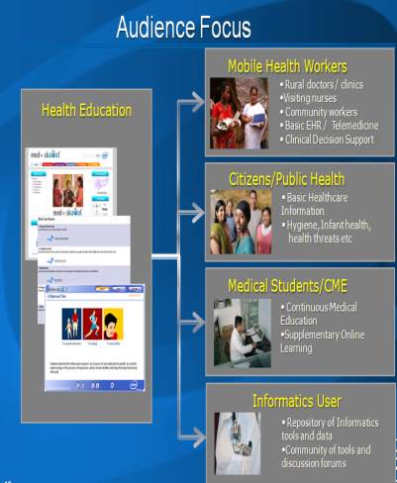
Notes:
Sri Lanka example showing login screen aimed at first time p.c. users who are primary health nurses
Initial focus is based on where capacity, access to healthcare and quality of care are huge issues (primary health) – especially under-served urban and rural areas
Flexibility for healthcare worker healthcare education and training with assessment to download and take training and assessments off-line and connect when there is internet access

Slide 12
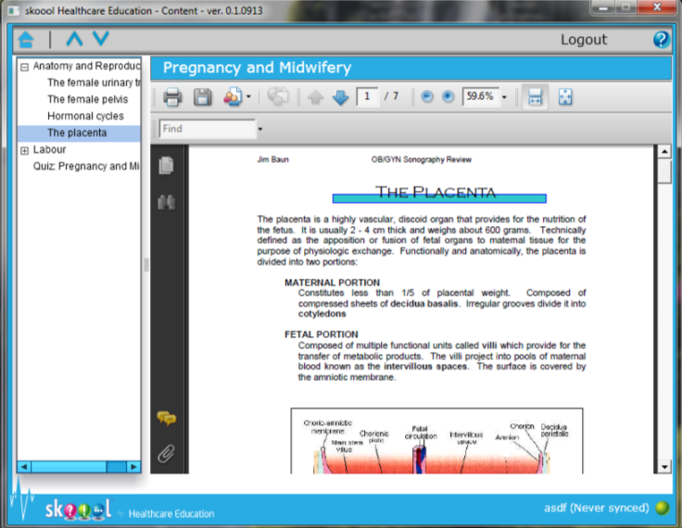
Supports existing content in many digital formats (video, audio, flash, pdf, html)
Notes:
Content Types
Multimedia (video, audio, flash, PDF, html)

Slide 13
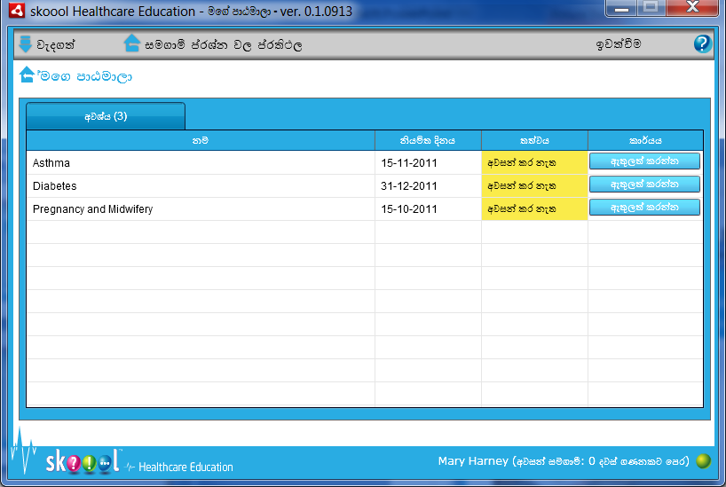
Health Worker View of Course List
Health Worker View of Selected Course
View list of courses, due dates, and color-coded completion status
Enter course to start or resume
Complete course
Summary Review
Notes:
Flexibility for healthcare worker healthcare education and training with assessment to download and take training and assessments off-line and connect when there is internet access to synchronize results of assessments and download additional training material
Healthcare workers can start assessments, save and resume later.
Content synchronisation has intelligent sync – when next connecting to the internet – only new course content is added,

Slide 14
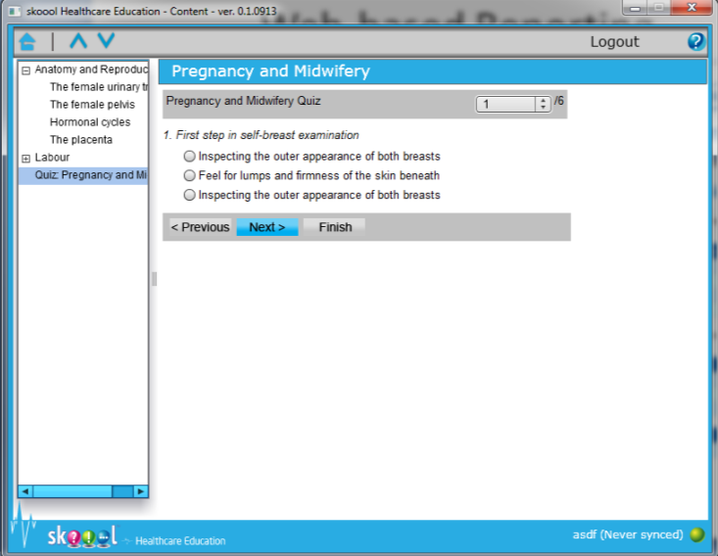
Health Worker View of Assessment
Take Assessment
Save and Report Assessment Results
Sync quiz results to the Internet when connected
Notes:
Content synchronisation has intelligent sync – when next connecting to the internet – only new course content is added,
The ability to drive continuous medical education and training with assessments is a huge asset. Many of these developing countries have very limited or no assessment capabilities for their existing healthcare workforce especially front-line (community, primary health).

Slide 15




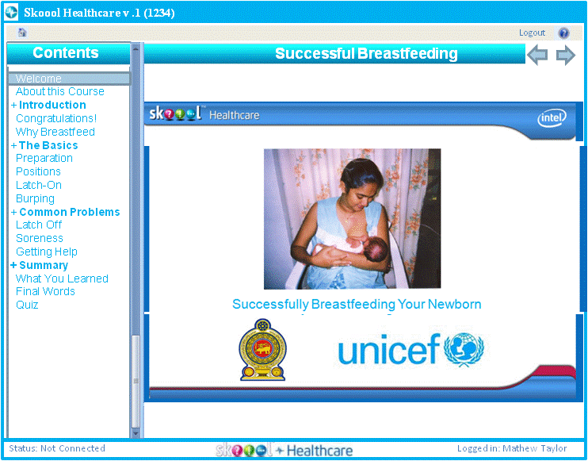




Continuous Medical Education - Primary Healthcare
Usage Model Example –
Primary & Community Healthcare Workers
Performance
Dashboard
State
Health-related officials at Village, e.g. District, and State levels
PHC
(Primary Health
Center)
Quiz Results
&
Usage Data
Multimedia
Content
&
Quizzes
OFFLINE
Field
LHV/ MO
MHW (Mobile Health Worker)
Notes:
Allows field healthcare workers to coordinate with administrators and (Ministries of Health – central, state, district and primary health center level and each other.

Slide 16
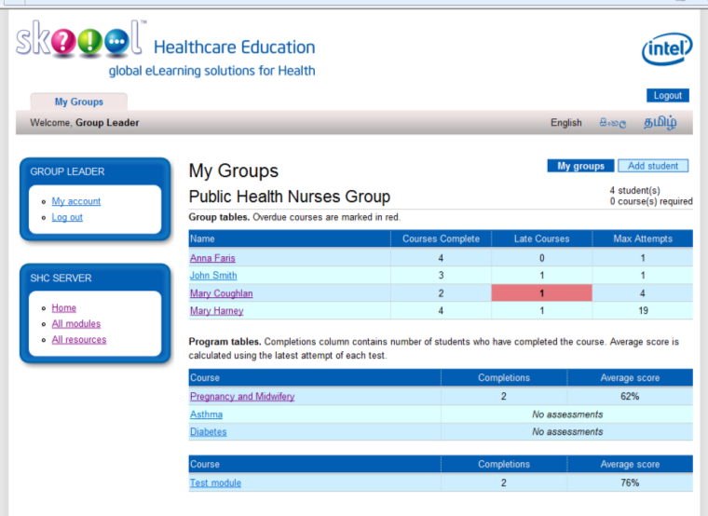

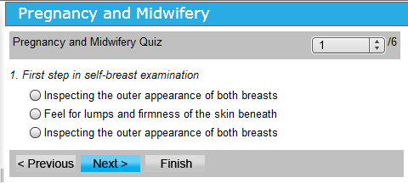
Helping to Improve Capacity Building & Standards in Healthcare Education & Trainings
Usage Model Example – Student Doctors & Nurses
Performance
Dashboard
Health
Education
Provider
Administrators
& Officials
Optional
Cache
Health
Center or
Campus
Test Results
&
Usage Data
Multimedia
Content
&
Assessment
OFFLINE
Mobile
Professors
& Health
Professionals
Students
or nurses

Slide 17
Web-based Dashboard Report
Administration, Monitoring and Tracking Assessment
Notes:
Could be real-time reporting on assessment and tracking

Slide 18
Enabling PPP Models for Sustainability & Scale
Local & International Content Providers
3rd Party non for profit, NGO, Academia, Med. Associations
G-T-M Private Sector Partners
Local ecosystem partners
ISV’s, Telco’s,
Intel skoool™ Healthcare Education Platform
Advocacy, Execution Support & Funding
NGOs, Govts, Development Agencies
Notes:
Engagement and go-to-market model for The Intel skoool™ Healthcare Education Platform
There are many possibilities, the strategic aim will be most;y based on public-private-partnership with Governments, NGOs, development banks, etc., as part of a government-assisted PC program (GAPP) and ICT skills program. Universal service funds (USF) could also be a funding source to contribute towards local content creation and pre-paid broadband pc bundles. In the case of Sri Lanka, which is the 1st country to commit to deploy the Intel skoool™ Healthcare Education Platform, local leading academic universities are helping to digitize the content and host the server application. The content sources are coming from both local Family Health Bureau, Medical Association and internationally.
See Intel internal Q&A

Slide 19

Come join the World Ahead
1Mx15 Health Program!
Contact Intel and start planning for your country’s
success today
http.//www.intel.com/worldahead
Notes:
The Intel World Ahead Program is connecting the next billion people to 21st century opportunities.
The Intel World Ahead Program mission is to connect the next billion people.
We do this by providing access to uncompromised technology, allowing everyone the potential to participate in 21st century education and economic opportunities.
Helps developing countries achieve important national objectives and realize the full value of their technology investments
Helps maximize return on technology investments and expand local IT industries and support structure

Slide 20
Intel World Ahead Program
Questions?

Slide 21
Intel World Ahead Program
Back-up

Slide 22
Challenges
57 Developing Countries with critical shortage of HC Workers
Huge impact on socio-economic development
Solution
skoool™ Healthcare Education Platform – major development
with new features, capabilities including pc app.
Enables Content Delivery, Tracking & Assessment online & offline
Includes Intel & 3rd Party SME Content
Delivers multimedia (html, video, flash, audio, pdf)
With or without Internet
Enabling & Sustainability Model
PPP collaboration – Govt., NGO, Internal & Local Content Providers
Open Access Licensing , PLS Tech Transfer, PC Basics, Easy Steps etc.
1M x 15 Health Program
Sri Lanka Presidential National Program announcement at UN Summit NY, 20+ countries in pipeline incl. SSA
22
Intel Confidential
Notes:
Capacity, Access, Quality massive issues in Emerging Markets HC
Average of 30x training program updates – MOH
Major challenges for Training & Education Assignment
Ineffective training leading to variable skill sets at the community level
Limitations around teaching aids for faculty resources
No or little Assessment – Standards
No Database to track skills at PHC level or above
Inability to do remote distance learning to keep resource in community
Management of programs MD, LMOH etc.
High turn-over of healthcare workers
Capacity Building - Inability to fast track training and recruitment of health workers
Information Dissemination to Beneficiary – Effective health education platform
Overload due to competing priorities e.g.. Data acquisition and reporting
Travel long distances to attend classroom training - community impact
Low levels of motivation – no tie in to career path, migration to urban and outside country
Lack of efficient support tools in the field
Student management: each student has it’s own profile and training can be tracked.
Combination of learning materials: this platform works like a real LMS allowing the integration of different learning materials in different platforms.
The platform interface can be customize to suit the user needs: they can develop a simple interface for trainees, with for instance the training they should do and for administrators they could have a dashboard on how everyone’s doing and create incentives
On client side PC app for mobile worker or distant student eLearning and patient engagement
Delivers multimedia content (html, video, flash, audio, pdf) without Internet!
Includes quizzes to verify understanding
Uploads usage/quiz data to facilitate worker management
At least 1m healthcare workers enabled using ICT/Skoool HC by 2015
Sri Lanka 1st country to announce at national level at UN Summit, Ghana and Nigeria hot on their heels

Slide 23
Frontline/Mobile Health Workers - Challenges
Mobile or Field Health Worker
  ~ 70% time spent on data entry; Multiple schemes and data entry requirements
  Carrying > 20 registers and multiple data fields in each register depending on country
  Repetition and redundancy of data entry
  Coverage of 5-6 villages and ~ 15 sq.km – scheduling and priority important
  No or minimum analytics to guide them
Government
  Smooth flow of accurate data and information in a timely fashion to allocate resources, prevent outbreaks etc.
  Training – pre-service (capacity building) and in-service (licensure, quality of care)
  Rapid Information dissemination to the mobile health workers and to the beneficiaries
  No record of skill levels of MHWs
Low motivation and high turnover of mobile health worker
  Efficiency and Productivity
  Career path

Slide 24
Healthcare Transformation
4 Vectors - enabling capacity, skills & new models of care
Data acquisition and analytics
Informational education content
Training and assessment
Field based Diagnostics

Slide 25

Digital Content
Enabling information and applications that improve lives
  Intel shares tools, technologies, content, and expertise to promote development of localized content
  Intel skoool™ online learning content in 20 countries and 7 languages
  Intel PC Basics learning content helps new users

Slide 26
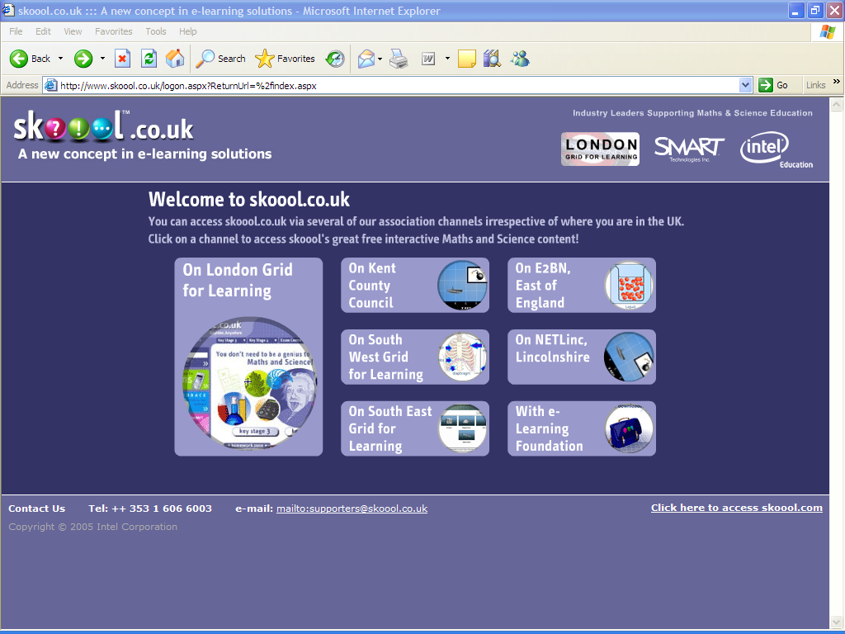
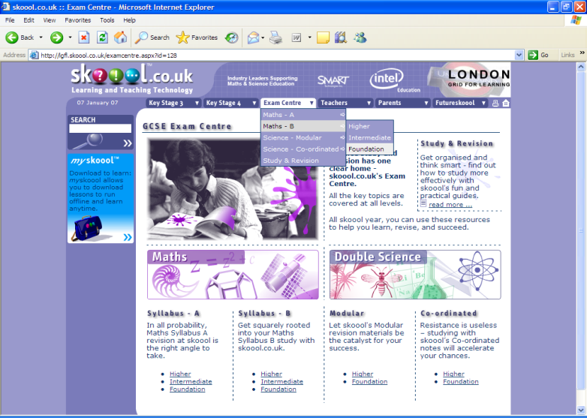
Content: award-winning skoool™
www.skoool.com
Notes:
Award-winning skoool™
Free online resource, developed by Intel, available in multiple countries and languages; currently being used in Europe, the Middle East, Africa, Southeast Asia, and a number of Spanish-speaking countries
Offers scalable, multimedia, multi-device online digital learning solution to improve the teaching and learning of mathematics and science
Adapted to the local curriculum and culture of many countries
Digital curriculum offers an adaptable educational content resource
RECOMMENDED
If possible, go to skoool.com online (live) to demonstrate.
From the home page select version/language desired.
Then click on “Sample skoool” and select “Breathing and Respiration”
OR click through the site to demonstrate. Math and Science sections are recommended.

Slide 27
Content Strategy – Areas of Interest
Key Usage Models | Target Audience | Objective | Example Content areas*
Training & Education (Phase 1 – 2012 - 2015) | Mobile Health Workers | In-service training Up skilling (CME) | ICT Literacy & Skills, Maternal & Child Health, NCDs
 | Students | Capacity building of midwives, nurses and doctors | ICT Literacy & Skills, Curriculum-based training
Informational Education (Phase 2 – 2013-2015) | Rural Citizens (delivered through health workers) | Health Info Dissemination | ICT Literacy & Skills, Family planning, MNCH, Hygiene & Sanitation
 | Citizens | Health Info Dissemination | ICT Literacy & Skills, School Health, NCDs, Communicable Diseases

Slide 28
Content Strategy – Creation & Delivery
Healthcare Content
Content providers
(Intl - WHO,UNFPA, Hesperian,
Local - MoH, FHB, local NGOs, Acads)
Digital & Multimedia Content Creation
Intel skoool™ Healthcare Education Platform
Images
Graphics
Target
Audience
e.g. Art Database (Hesperian)
Local ecosystem
(ISVs, Univ.)
Localization
(Language, Images,
Cultural relevance etc.)
Deliver multiple content types
anytime & anywhere
with assessment
Enabling Tools
Pedagogical BKMs (Intel PLS)
PC Basics (Intel)
Translation
Voice-over

