Slide 1


“Educate to Innovate”
Intel ® Education Initiative in China
March 2010
1
Notes:
1
“Educate to Innovate” is the USG’s campaign on education. We borrowed this phrase as indirect translation of the China Education thought leadership campaign theme: 教育推动创新，梦想成就未来

Slide 2


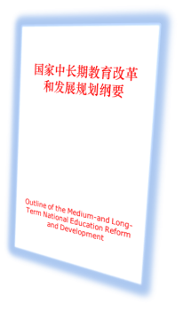
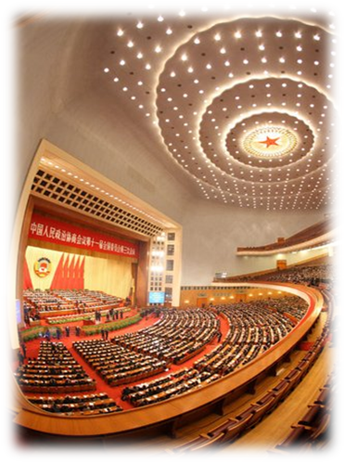



“Education is Fundamental to National Development”
Innovation Nation
First-class Innovative Talents
First-class Education
Reinvigorating China through
innovation and education,
Strengthening the nation through
talent development
National People’s Congress, 2010

Slide 3
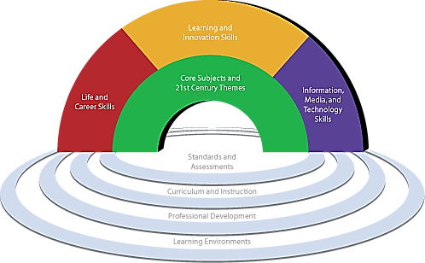
21st Century Skills
Graphic is used by permission of the Partnership for 21st Century Skills.

Slide 4
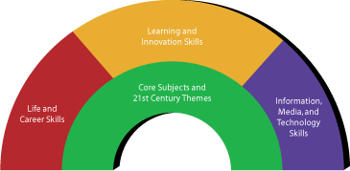



Intel® Education Initiative: Transforming 21st Century Teaching and Learning
Graphic is used by permission of the Partnership for 21st Century Skills.
Improving Teaching
and Learning
Innovative Talent Cultivation
Innovation Education Ecosystem

Slide 5


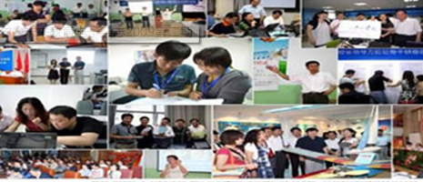







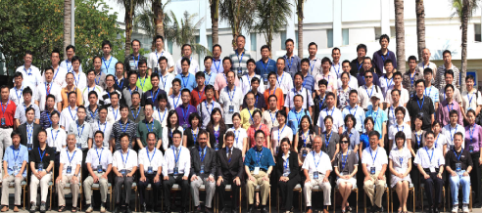

Intel® Education Initiative
Intel® Teach
Intel® Learn
Intel® Higher education Program
Improving Teaching
and Learning
K-12 students: Intel ISEF, CASTIC
University students: contests, scholarship, innovation programs
Innovative Talent
Cultivation
Intel China Academic Forum
Education Innovation Summit
Innovation Education
Ecosystem

Slide 6
IMPROVING TEACHING AND LEARNING
Improving Teaching
and Learning

Slide 7


Improving Teaching and Learning
Improving Teaching
and Learning
Intel® Higher Education Program
Intel® Teach
Intel® Learn
Help teachers effectively integrate technology into classroom teaching
Extend learning opportunities beyond the classroom into the community to cultivate 21st century skills
Enhance university Education and research

Slide 8


Intel® Teach
10 years in China
>1.5M teachers trained
1/5 of global teachers trained
“We believe quality education is the foundation for opportunity and innovation.”
Paul Otellini

Slide 9


Intel® Learn
350K young students
>456 training centers
~1700 teachers

Slide 10

Intel® Higher Education Programs
Curriculum Development
>100 universities
Faculty Training
~400 faculties
Joint Research
  Joint research fund, Post-doctorate program, visiting scholars

Slide 11
INNOVATIVE TALENT CULTIVATION
Innovative Talent
Cultivation

Slide 12

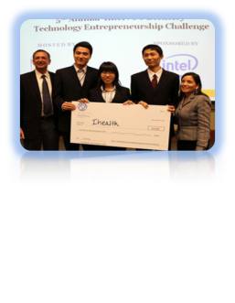
Innovative Talent Cultivation
Innovative Talent
Cultivation
K-12 students:
Intel ISEF, CASTIC
University students: contests, fellowships, student innovation programs

Slide 13
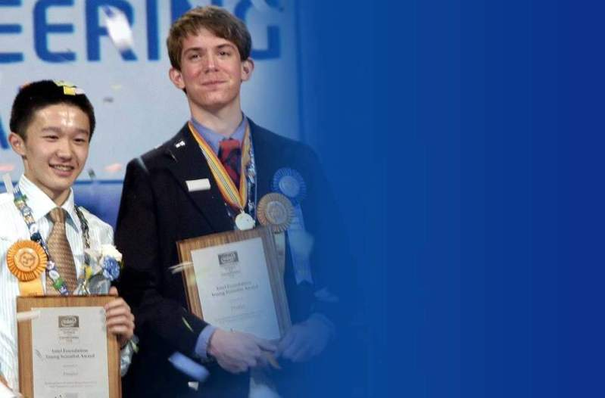
Intel ISEF
236 students
156 projects
155 awards
From China since 2000

Slide 14
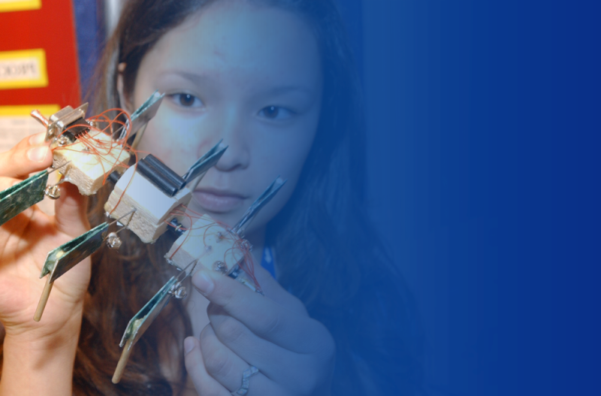
Inspiring Innovation in Universities
Embedded Design Contest
Multi-core Programming Contest
Technology Entrepreneurship Program
Student Innovation Essay Contest
Fellowship
Internship
Lectures, student clubs

Slide 15

INNOVATION EDUCATION ECOSYSTEM

Slide 16
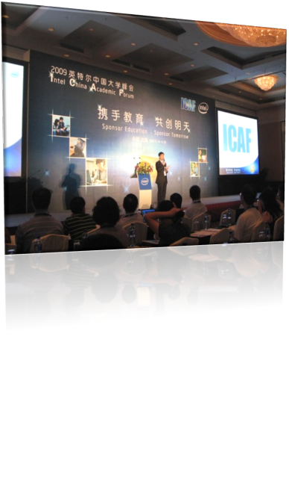
Forums
Intel China Academic Forum
Online community, forums, webinars
Ecosystem for industry, academia and research collaboration

Slide 17

Partnership for Education Innovation
Intel Education Innovation Summit
Theme
Cooperation, Inspiration, Innovation
On Outstanding Innovative Talent Cultivation
Time: June 2010

Slide 18
SUMMARY

Slide 19

Intel® Education Initiative:
Success for the 21st Century
"The foundation of tomorrow’s innovation is education. That’s why making quality education available to more students around the world – with the help of technology – has inspired Intel’s commitment to education for 40 years.”
Paul Otellini,
President and Chief Executive Officer, Intel Corporation

Slide 20

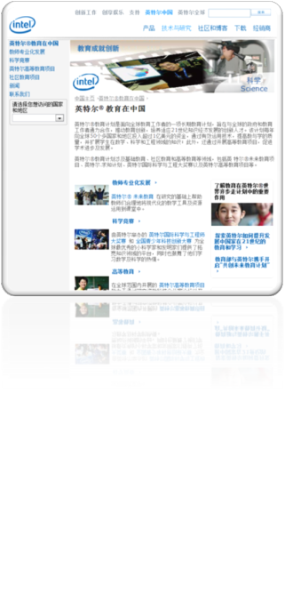
Recognized Contribution to Education
Win the Award “Outstanding Contributions to China Education” by Ministry of Education for 7 consecutive years.

Slide 21

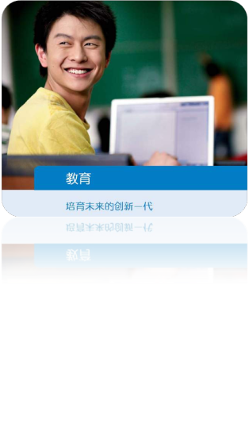
Investing in Education
-- Consistent CSR Commitment
What can we make possible?
Inspiring the Next Generation of Innovators!

Slide 22
“Educate to Innovate”
22

Slide 23


